Slide 1
Help America Vote Verification: Data Issues to Explore
Earl F Glynn efglynn@gmail.com watchdoglab.substack.com/p/questions-about-help-america-vote github.com/EarlGlynn/HAVV-analysis
2024-10-03
Notes:
Jeff O'Donnell (aka The Lone Raccoon) was pioneer in the analysis of HAVV data
Yearly summary of all states 2018-2024
https://magaraccoon.com/havv.asp

Slide 2
HAVV Data Issues to Explore
HAVV Background: Conceptual Process
Research Questions
Sample HAVV Sheet
Example State HAVV Charts [Maryland]
Breakdown of HAVV in the States
Near 100% Nonmatch Rates (sometimes) [8] CA, GA, MD, MI, NE, NV, NY, TX
Current HAVV Data Issues [19] AL, AK, AZ, AR, CO, IA, IL, KS, MA, MO, MT, NC, OH, OR, PA, RI, SD, UT , VT
States with “Consistent” Reporting [11] CT, FL, ID, IN, LA, MN, MS, NJ, WA, WI, WY
Low Transactions or Minimally Participating [6] DE, DC, HI, ME, NH, OK
Not Participating in HAVV [7]
Online GitHub Resources
KY, NM, ND, SC, TN, VA, WV

Slide 3
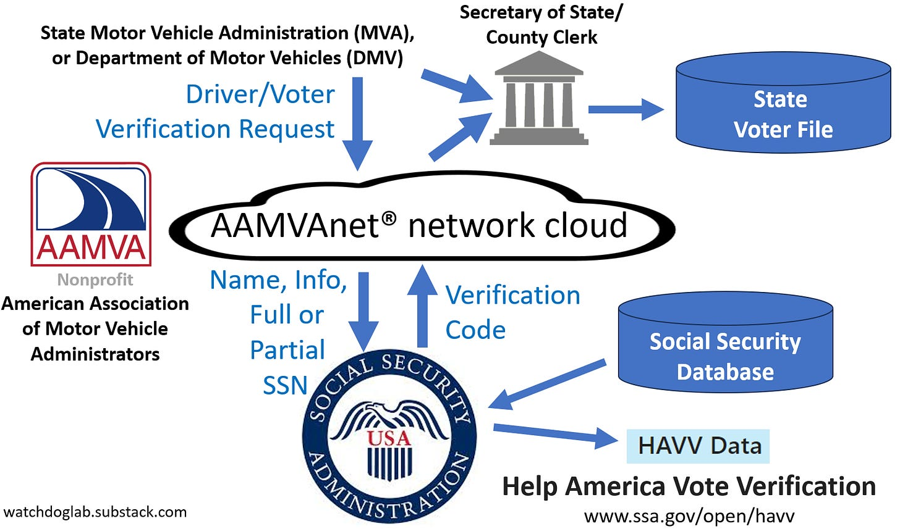
HAVV Background: Conceptual Process
Questions about Help America Vote Verification data in many states https://watchdoglab.substack.com/p/questions-about-help-america-vote
Notes:
Kansas Agreements:
KS Dept of Revenue and Secretary of State [2004, 2006, 2012]
2004: ALL drivers liense records will be verified with the Social Security Administration
2012: 5-digit zip is not considered “personal information”
Both agencies have “contact” person
“Limit access only to those indivdiuals directly responsible”
Silent about reports except for quarterly reports for non-driver IDs
“Nothing in this MOU shall prohibit the SOS from disclosing aggregate information derived from such records as long as protected, personal information is not disclosed.”
KS Dept of Revenue and Social Security Administration [2004]
The DEPARTMENT will verify all drivers license records with the Social Security Administration
The American Association of Motor Vehicle Administrators' (AAMVA) subsidiary AAMVAnet, Inc. is hereafter deemed the "agent" for the Kansas Department of Revenue for billing purposes and will serve as the conduit to transmit information to and receive information from SSA, consistent with the terms of this Agreement. AAMVAnet, Inc. will transmit information to and receive information from SSA on behalf of the Kansas Department of Revenue.
SSA agrees to compare the information fiunished by the Kansas Department of Revenue withinformation in SSA's Master Files of Social Security Number (SSN) Holders and SSN Applications system of records. SSA will respond to the Kansas Department of Revenue through AAMVAnet, Inc. with one of the following responses:
UNI Value = 1 Both name and date of birth (DOB) match
UNI Value = 2 Invalid SSN
UNI Value =3 Name does not match, DOB matches
UNI Value =4 DOB does not match, name matches
UM Value =5 Both name and DOB do not match
UNI Value = 6 We are unable to process the information for the SSN provided. Please
review your information or have your customer visit a Social Security
Administration office.
UNI Value = 9 System error, unable to process at this time.
Progressive connection: Pierre Omidyar’s Democracy Fund publication: Motor Vehicle Departments: Bedrock of American Democracy https://democracyfund.org/idea/motor-vehicle-departments-bedrock-of-american-democracy/ 2021_DF_MotorVehicleDepartmentReport.pdf
Information Exchange Agreement between [state] and the Social Security Administration 2021-2026
https://www.ssa.gov/dataexchange/documents/SSOLV%20model.pdf SSOLV model.pdf
AAMVA Products & Services Catalog
https://www.aamva.org/getmedia/dfdebfd6-1877-4fba-808c-084013e1ec0a/Products-Services-Catalog-Government-Rate-October-2021.pdf NetworkServices-GovtRateSchedule.pdf

Slide 4
Research Questions
Are high HAVV nonmatching rates or high matching deceased rates part of election shenanigans?
Are such high rates indictive of attempts to register non-citizens to vote?
What explains wide HAVV differences among all the states?
When data suggest unusally high HAVV nonmatch rates or high matching deceased rates in a state at a particular time, how can anyone explore the cause at a specific site?
Why is there no feedback loop to address problems through Social Security Administration or the states?

Slide 5
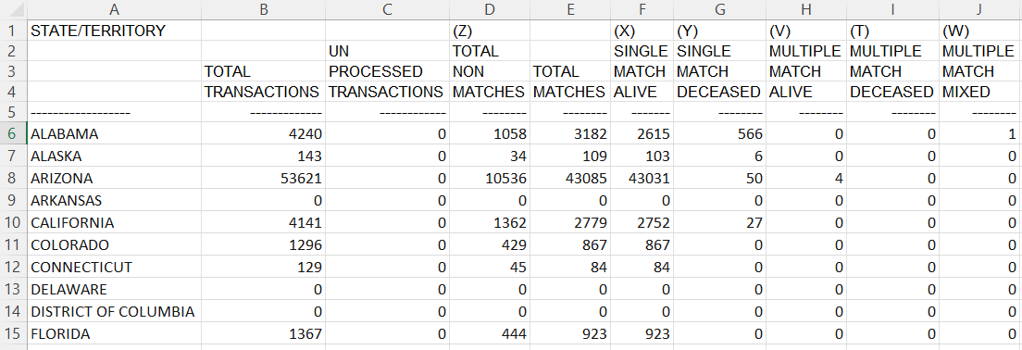

Sample HAVV weekly sheet One of 721 sheets
www.ssa.gov/open/havv/
Week: July 13, 2024
Data fields used in analysis
. . .
Notes:
C:\efgArchive\2020s\2024\R\HAVV\2024-07-13\HAVV-Recent-Sheet-2024-07-13.xlsx

Slide 6
Focus
Total Transactions
Percent Non Matching Transactions Percent NonMatch = 100 * Z_Total_Nonmatches / Total_Transactions
Percent Matching Deceased Transactions Percent Match Deceased = 100 * (Y_Single_Match_Deceased + T_Multiple_Match_Deceased) / Total_Matches
Percentages provide common comparison metric across all states
Percentages can have a “small n” problem with low denominators
10-Year Time Series (500+ points) Study variation over time
PowerPoint “Analysis of HAVV Data: Technical Details” shows how time series were extracted from online Social Security data

Slide 7
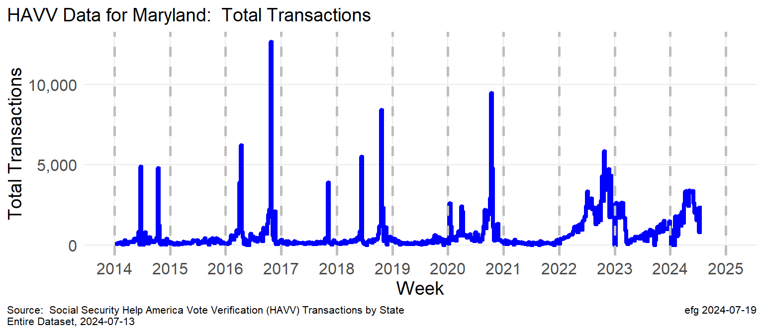
Example: Total Transactions in Maryland
2014, 2016, 2018: spikes before primary and general elections
2020: Two spikes earlier in year; spike before Nov. election
2022-2024: New normal? Year-round electioneering?
Notes:
C:\efgArchive\2020s\2024\R\HAVV\2024-07-13\States-Plots\
Maryland-TotalTransactions.png

Slide 8
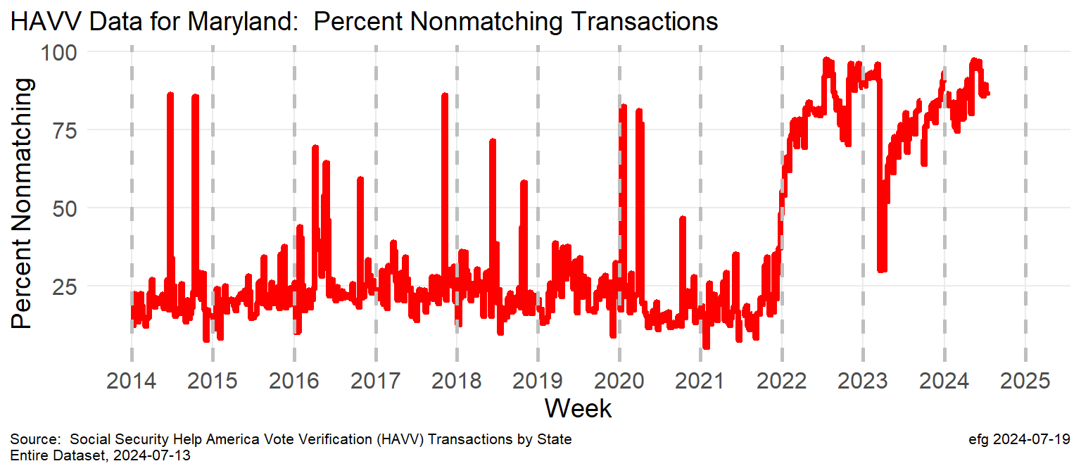
Example: Percent Non Matching Transactions
2014-2020: ~25% non-match rate is typical nonmatch 75+% spikes correlate to many of the total transaction spikes
2022-2024: New normal? 75+% nonmatch rate most of the year
Notes:
C:\efgArchive\2020s\2024\R\HAVV\2024-07-13\States-Plots\ Maryland-PercentNonMatch.png

Slide 9
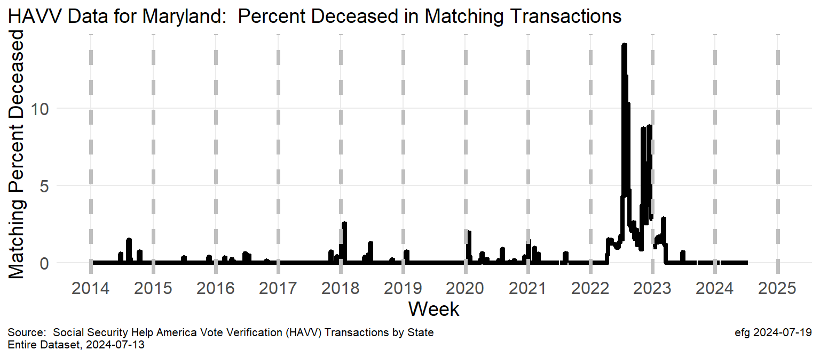
Example: Percent Matching Deceased Transactions
2014-2022: Relatively minor spikes in higher death match rates at times of transaction spikes
2022-2023: Why did death match rates swell in 2022?
Notes:
C:\efgArchive\2020s\2024\R\HAVV\2024-07-13\States-Plots\ Maryland-PercentMatchDeceased.png

Slide 10
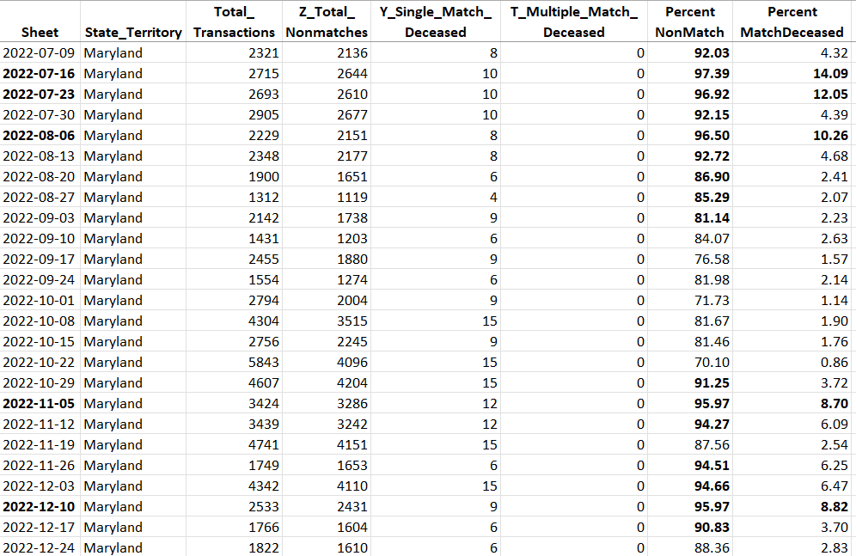
Example: HAVV data corresponding to charts
Maryland-HAVV-through-2024-07-13.xlsx
Sheet column can be used to verify data against www.ssa.gov/open/havv/
Many Excel columns are hidden here. All HAVV data are in the file.
Sheet name identifies the week ending date for when the problem happened.
But where in the state did the problem occur?
Notes:
Can quickly verify data provenance back to SSA web page: https://www.ssa.gov/open/havv/
C:\efgArchive\2020s\2024\R\HAVV\2024-07-13\States-Data\ Maryland-HAVV-through-2024-07-13.xlsx

Slide 11
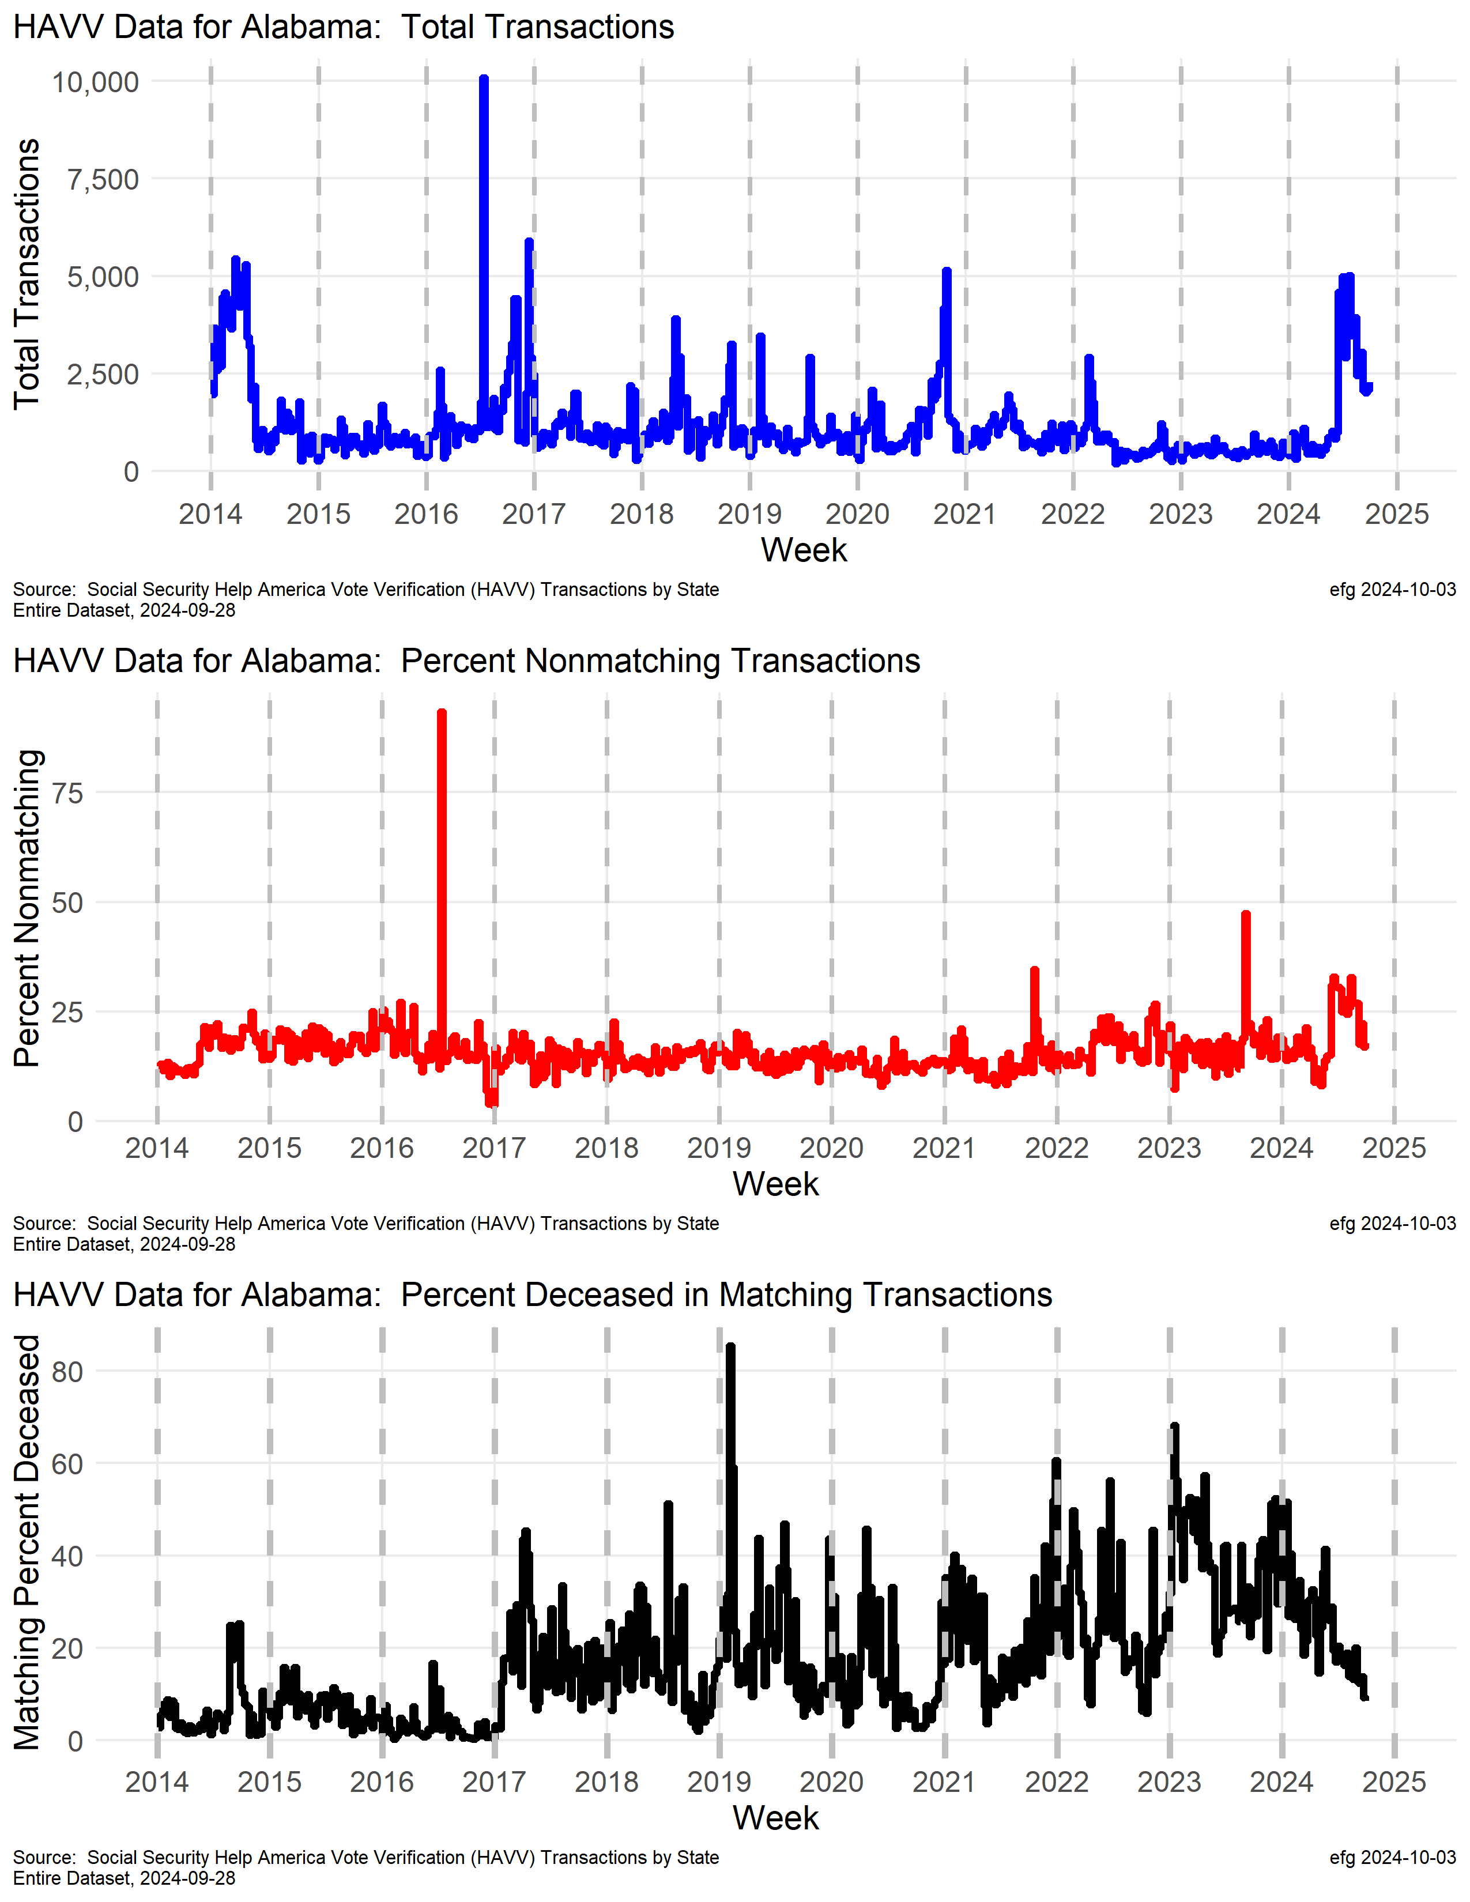
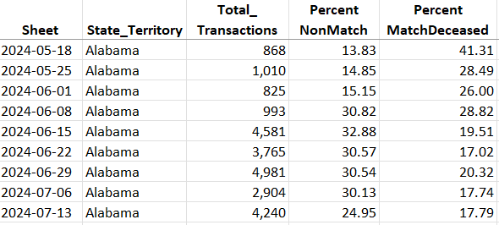
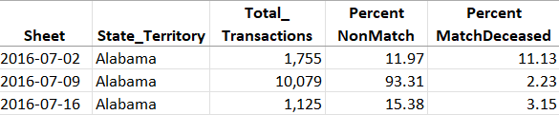
Alabama
Very recent spike in transactions and increased nonmatching transactions.
Why has the deceased match rate been mostly 20+% since 2017?
What happened before the 2016 election?
Notes:
C:\efgArchive\2020s\2024\R\HAVV\2024-07-13\State-Plots\
Alabama-HAVV-Data-2024-07-13.png
C:\efgArchive\2020s\2024\R\HAVV\2024-07-13\States-Data\
Alabama-HAVV-through-2024-07-13.xlsx

Slide 12
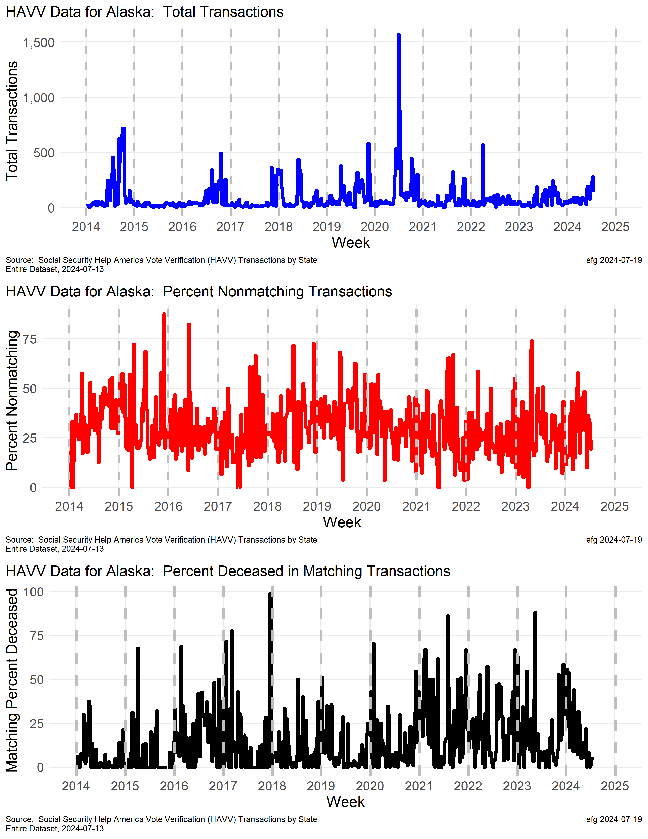
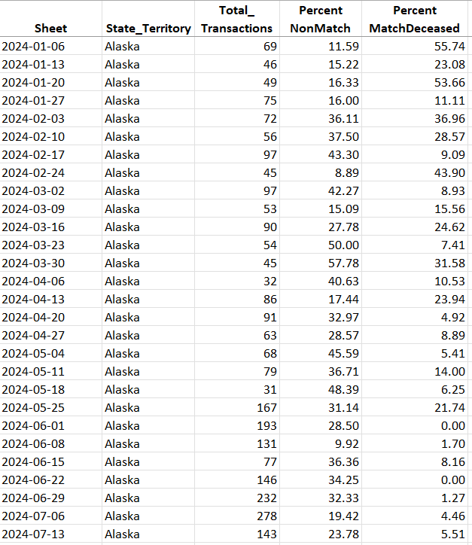
Alaska
2024 shows declining deceased matching rate, but the rate was over 50% earlier this year. What changed?
Small “n”
Notes:
Member of ERIC: https://ericstates.org/about/

Slide 13
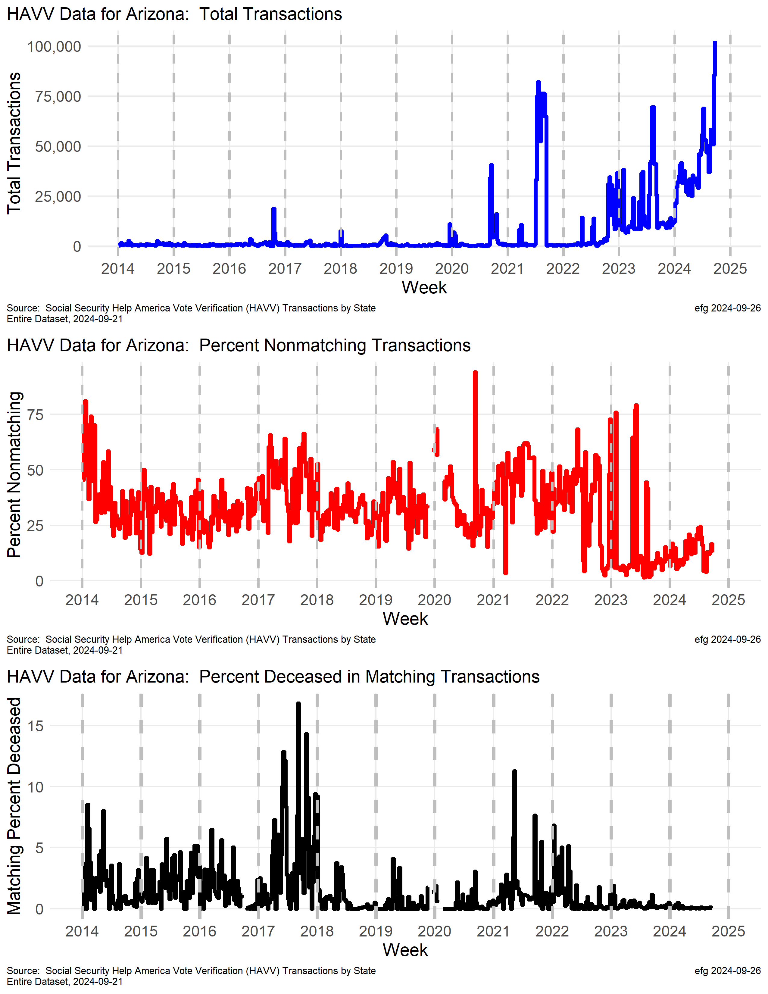
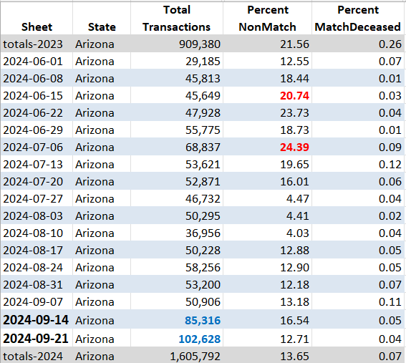
Arizona
watchdoglab.substack.com/p/ questions-about-help-america-vote
For second consecutive week HAVV total transactions set all-time record high.
Week ending Sept. 21. (green arrow)
Notes:
Arizona is a member of ERIC: https://ericstates.org/about/
2024-09-26
https://x.com/EarlGlynn/status/1839420283536723988
New Help America Voter Verification (#HAVV) data released by Social Security Administration for week ending Sept. 21.
In Arizona for second consecutive week HAVV total transactions set all-time record high. @RealAmVoice @Rach_IC @iVoteArizona @EIWatchdogs
2024-09-19
https://x.com/EarlGlynn/status/1836817041946181789
The Arizona 2024 HAVV transactions to date (2024-08-31) are 1,366,942, which is already higher than their 2023 total 909,380. @WallStreetApes @Eiwatchdogs
Why are Arizona HAVV weekly transactions erratic but trending upward in 2023-2024?
2024-09-10 https://x.com/EarlGlynn/status/1833597105879060976
Social Security just dropped the latest Help America Vote Verification (#HAVV) Data for week ending Sept. 14. https://ssa.gov/open/havv/ Arizona set all-time record high for HAVV transactions with 85,316. About 16.5% did not match Social Security records. @EIWatchdogs
@Rach_IC @iVoteArizona
2024-08-20 https://x.com/EarlGlynn/status/1826001627511222486
Help America Vote Verification (HAVV) Mystery #4: Arizona
Why are HAVV total transactions erratic but trending upward in 2023-2024 in AZ?
AZ has some large swings in nonmatching rates since mid-2022. Sometimes lower in late 2023 than 2022, but steadily increasing.
Social Security’s HAVV seems to be designed so problems cannot be traced to their source. https://watchdoglab.substack.com/p/questions-about-help-america-vote…
Member of ERIC: https://ericstates.org/about/
Joined ERIC: https://electionacademy.lib.umn.edu/2018/01/02/arizona-becomes-latest-state-to-join-eric/
The Arizona 2024 HAVV transactions to date (2024-08-31) are 1,366,942, which is already higher than their 2023 total 909,380. @WallStreetApes
@EIwatchdogs

Slide 14
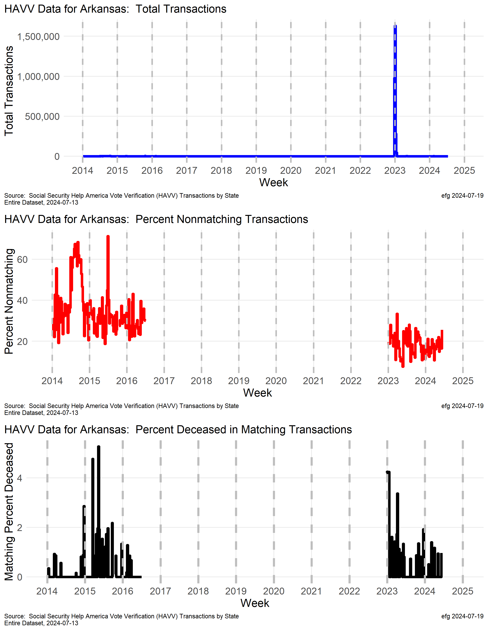
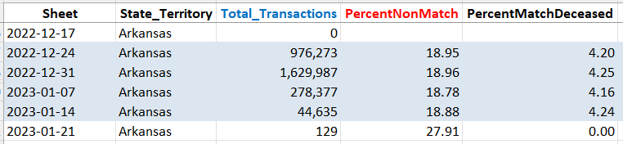
Arkansas
Whole State?
Processed all Arkansas voters in late 2022 and early 2023?

Slide 15
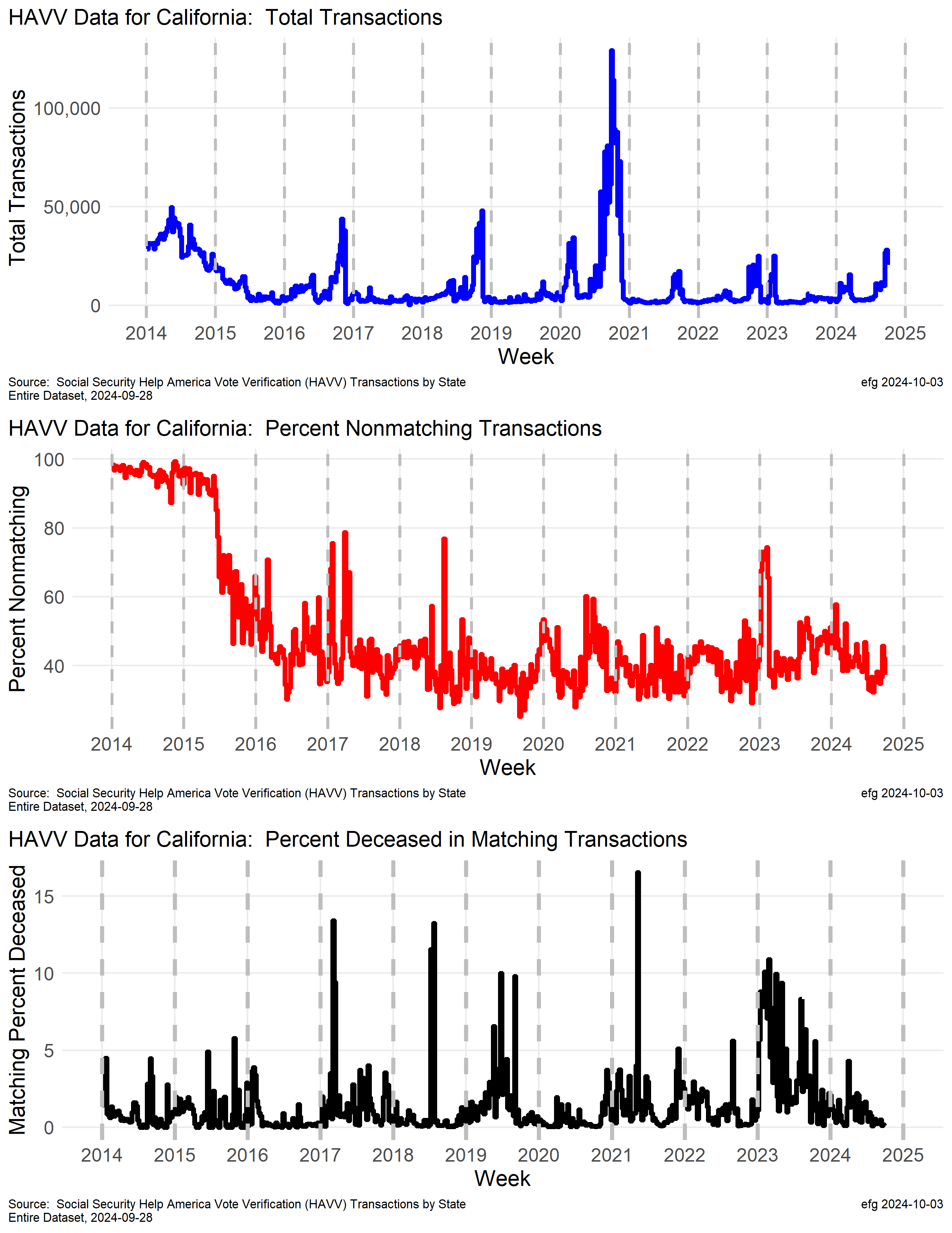
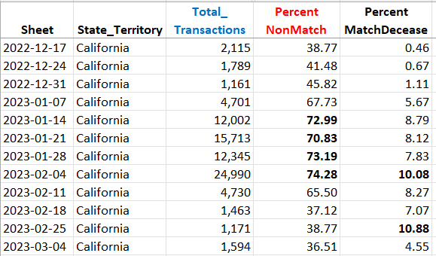
California
Huge transactions spike in late 2020 prior to election.
Near 100% nonmatch rate in 2014 and 40+%. Since then.
Spike in nonmatch rate in early 2023 corresponds to high match deceased rate.
Notes:
Timelines are NOT QUITE aligned between the three charts. [Difficult problem to fix for now.]

Slide 16
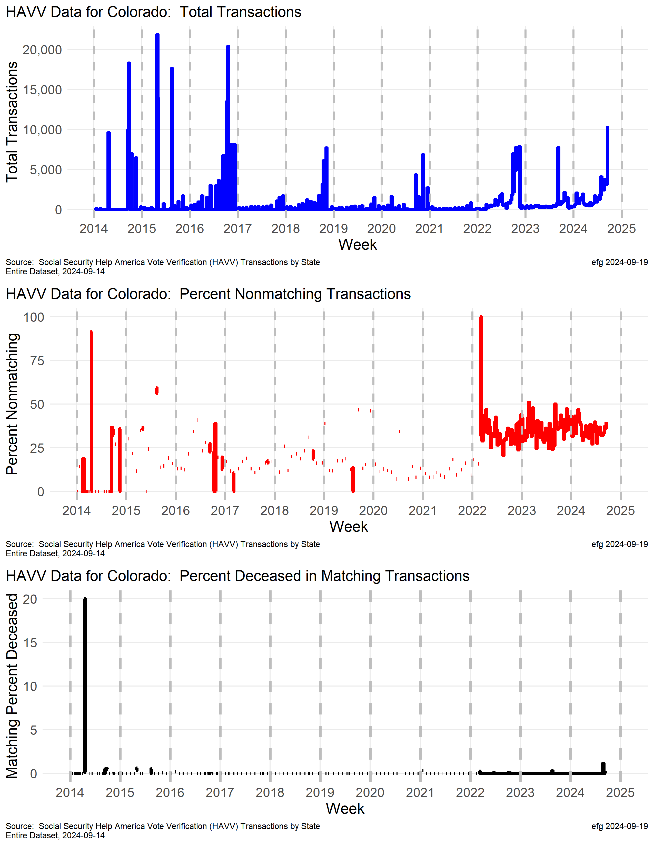
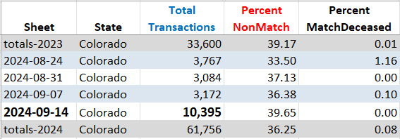
Colorado
For week ending Sept 14, 2024, Colorado set highest HAVV weekly transaction rate since 2016.
Why does Colorado have ~35% non
match rate?
Before 2022 Colorado’s HAVV reporting was not weekly, with
sporadic and often monthly reports.
100% of 1
Notes:
2024-09-21 https://x.com/EarlGlynn/status/1837578130493771881
Member of ERIC: https://ericstates.org/about/
Voter registrations through the DMV are “checked” via the Help America Vote Verification (#HAVV) system. https://www.ssa.gov/open/havv/
For the week ending Sept. 14, Colorado set its highest HAVV weekly transaction rate since 2016.
Since 2022 about 35% of Colorado’s HAVV transactions do not match any Social Security records.
Before 2022 Colorado’s HAVV reporting was not weekly, with sporadic and often monthly reports.
Colorado is a member of Electronic Registration Information Center (@ERICstates_info).

Slide 17
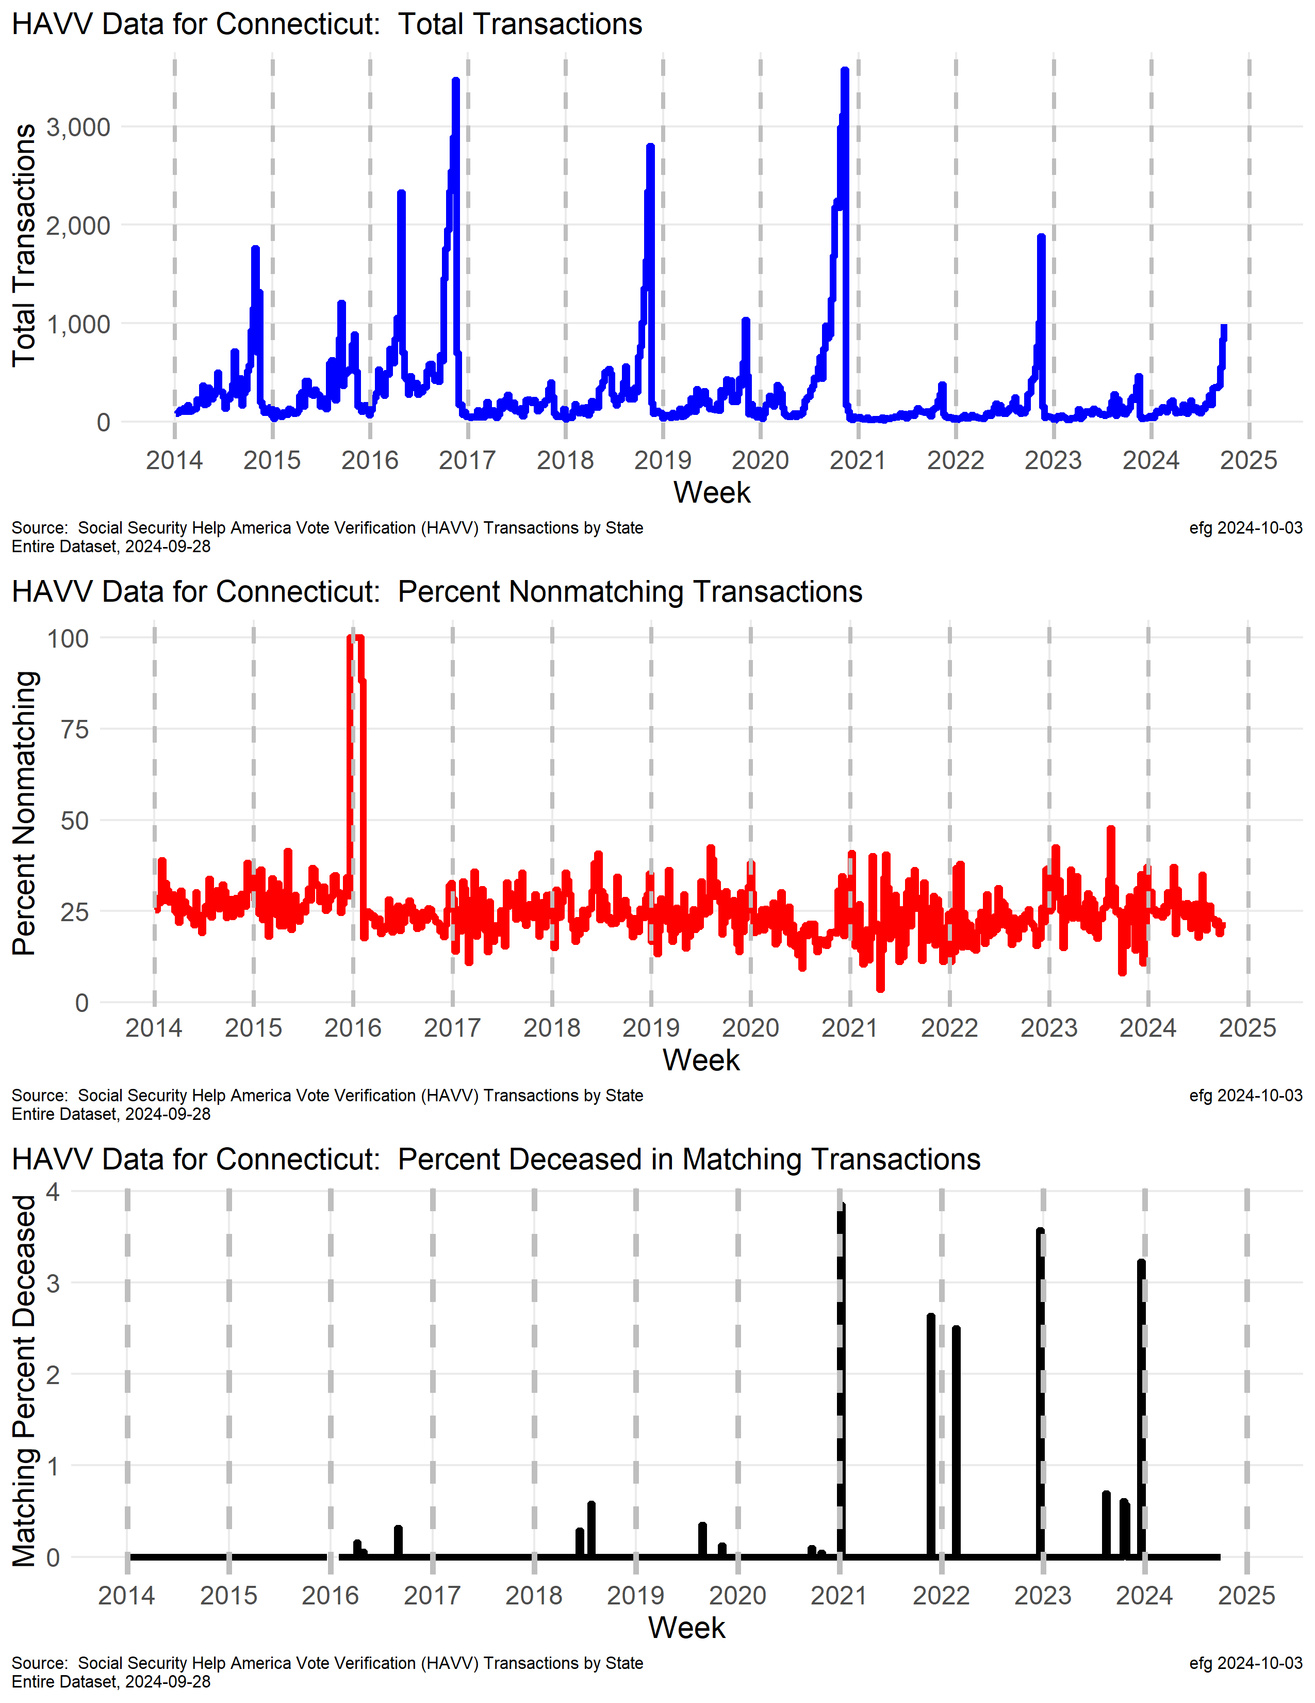
Connecticut
Notes:
Member of ERIC: https://ericstates.org/about/

Slide 18
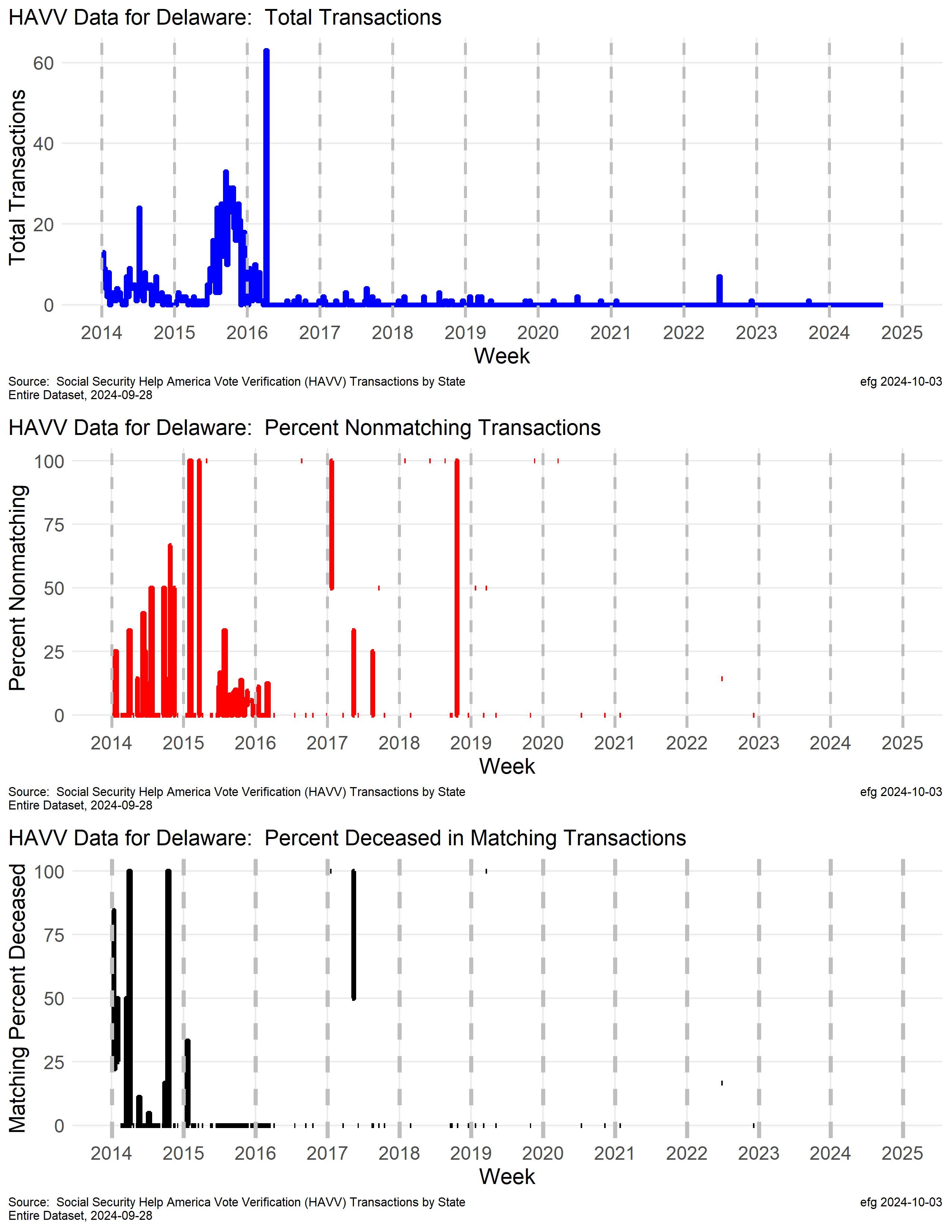
Delaware
Notes:
Not very active

Slide 19
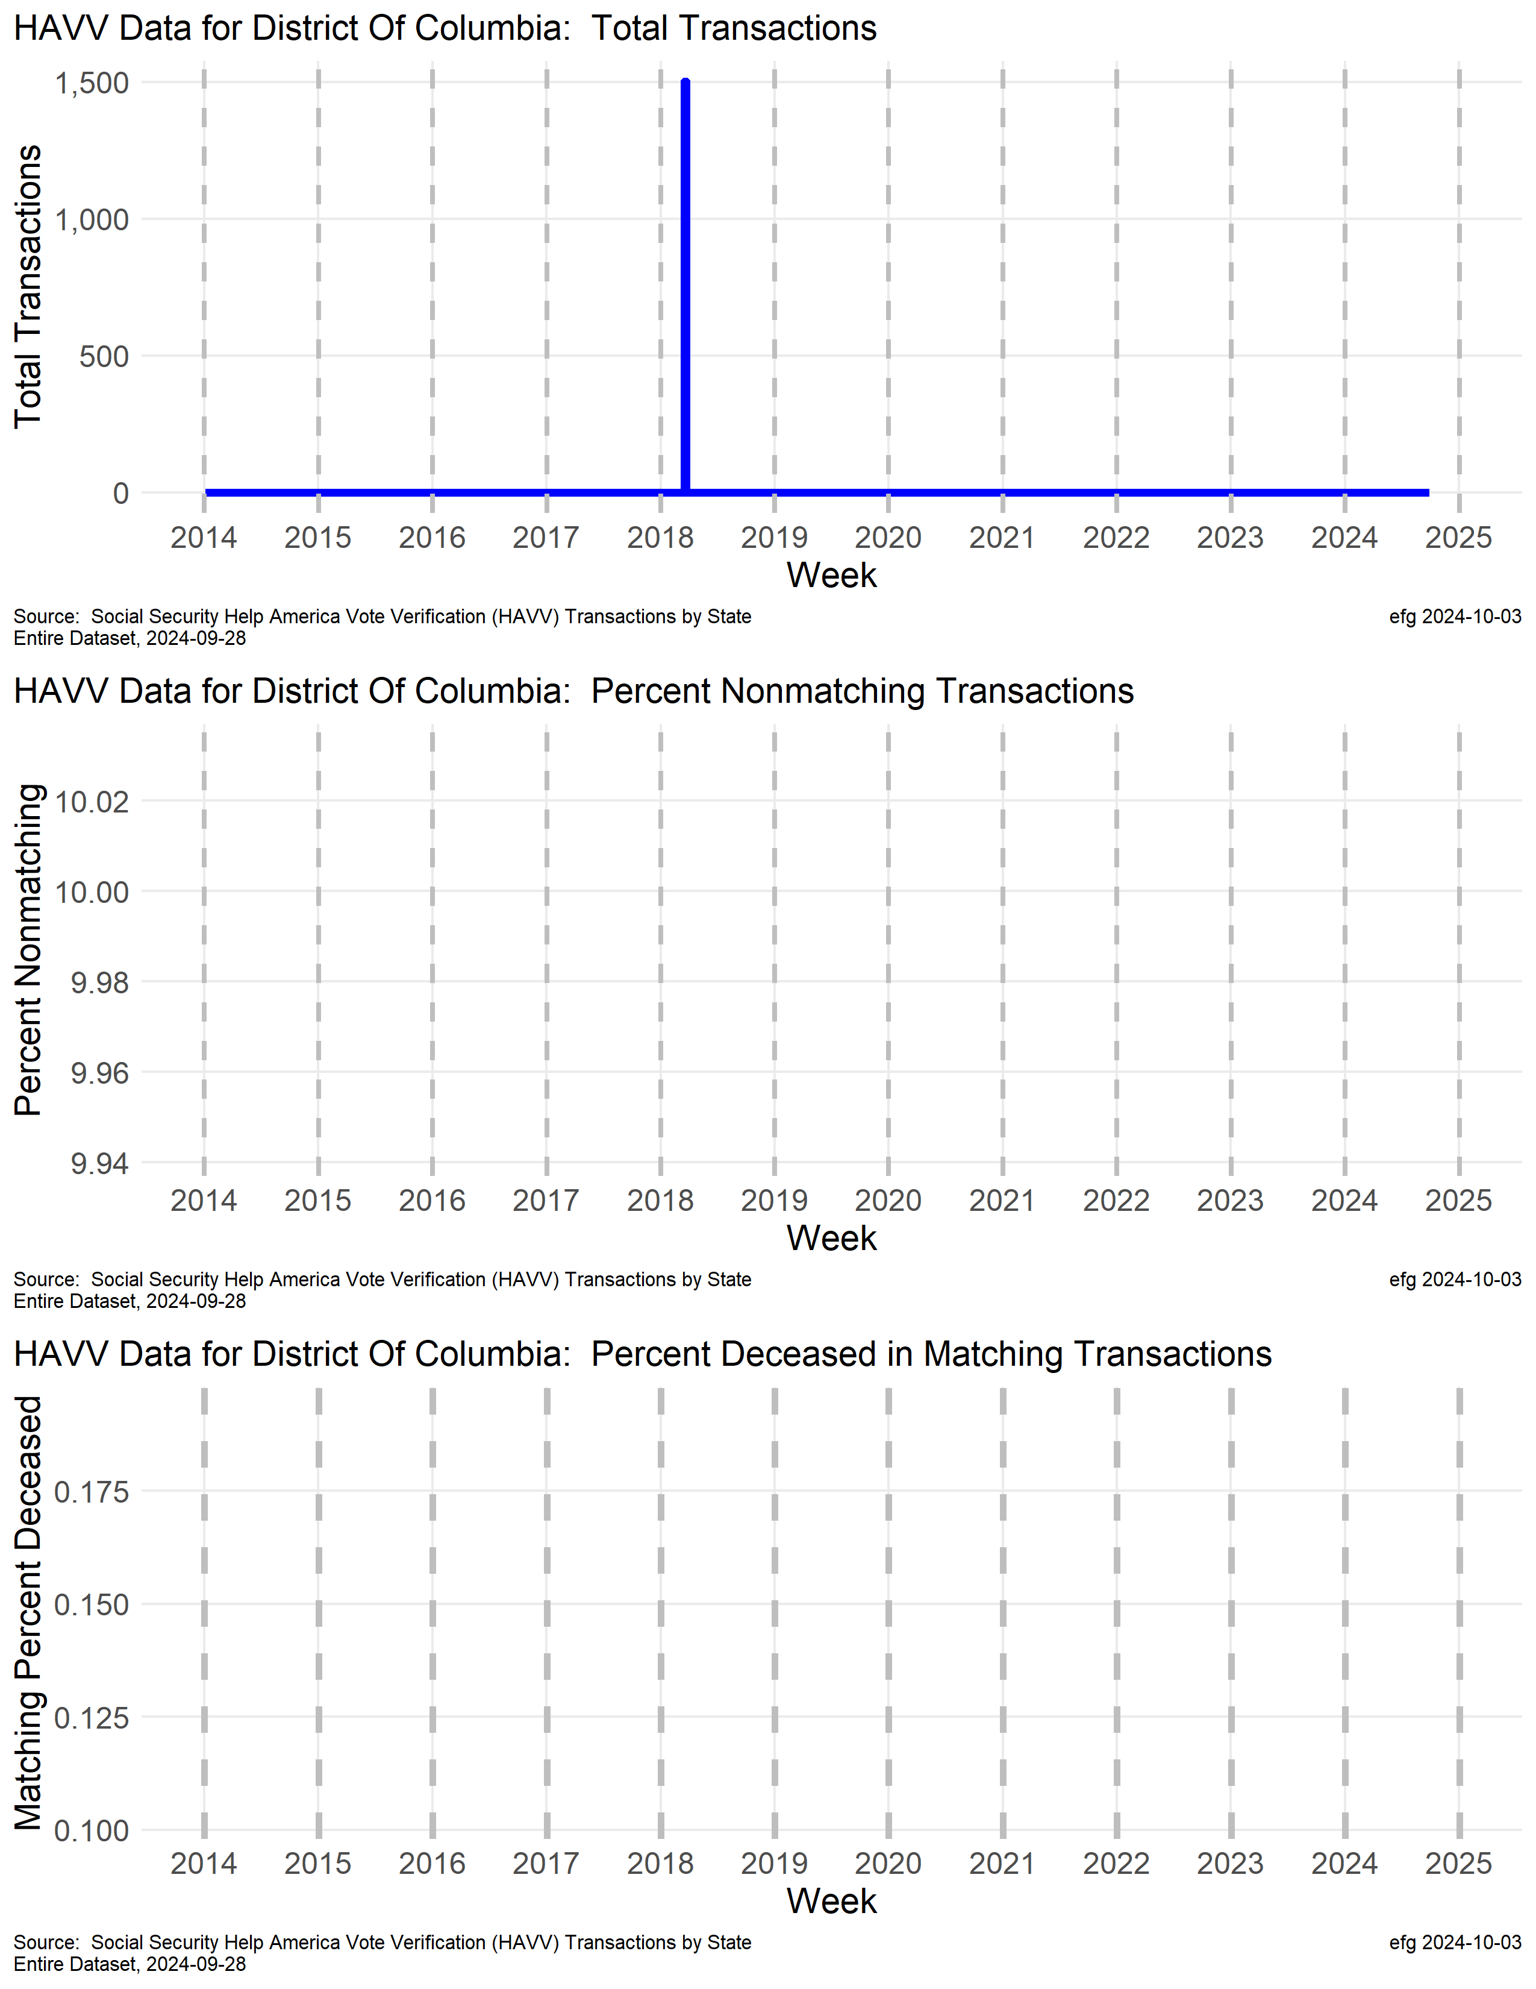
District of Columbia
Notes:
Not active

Slide 20
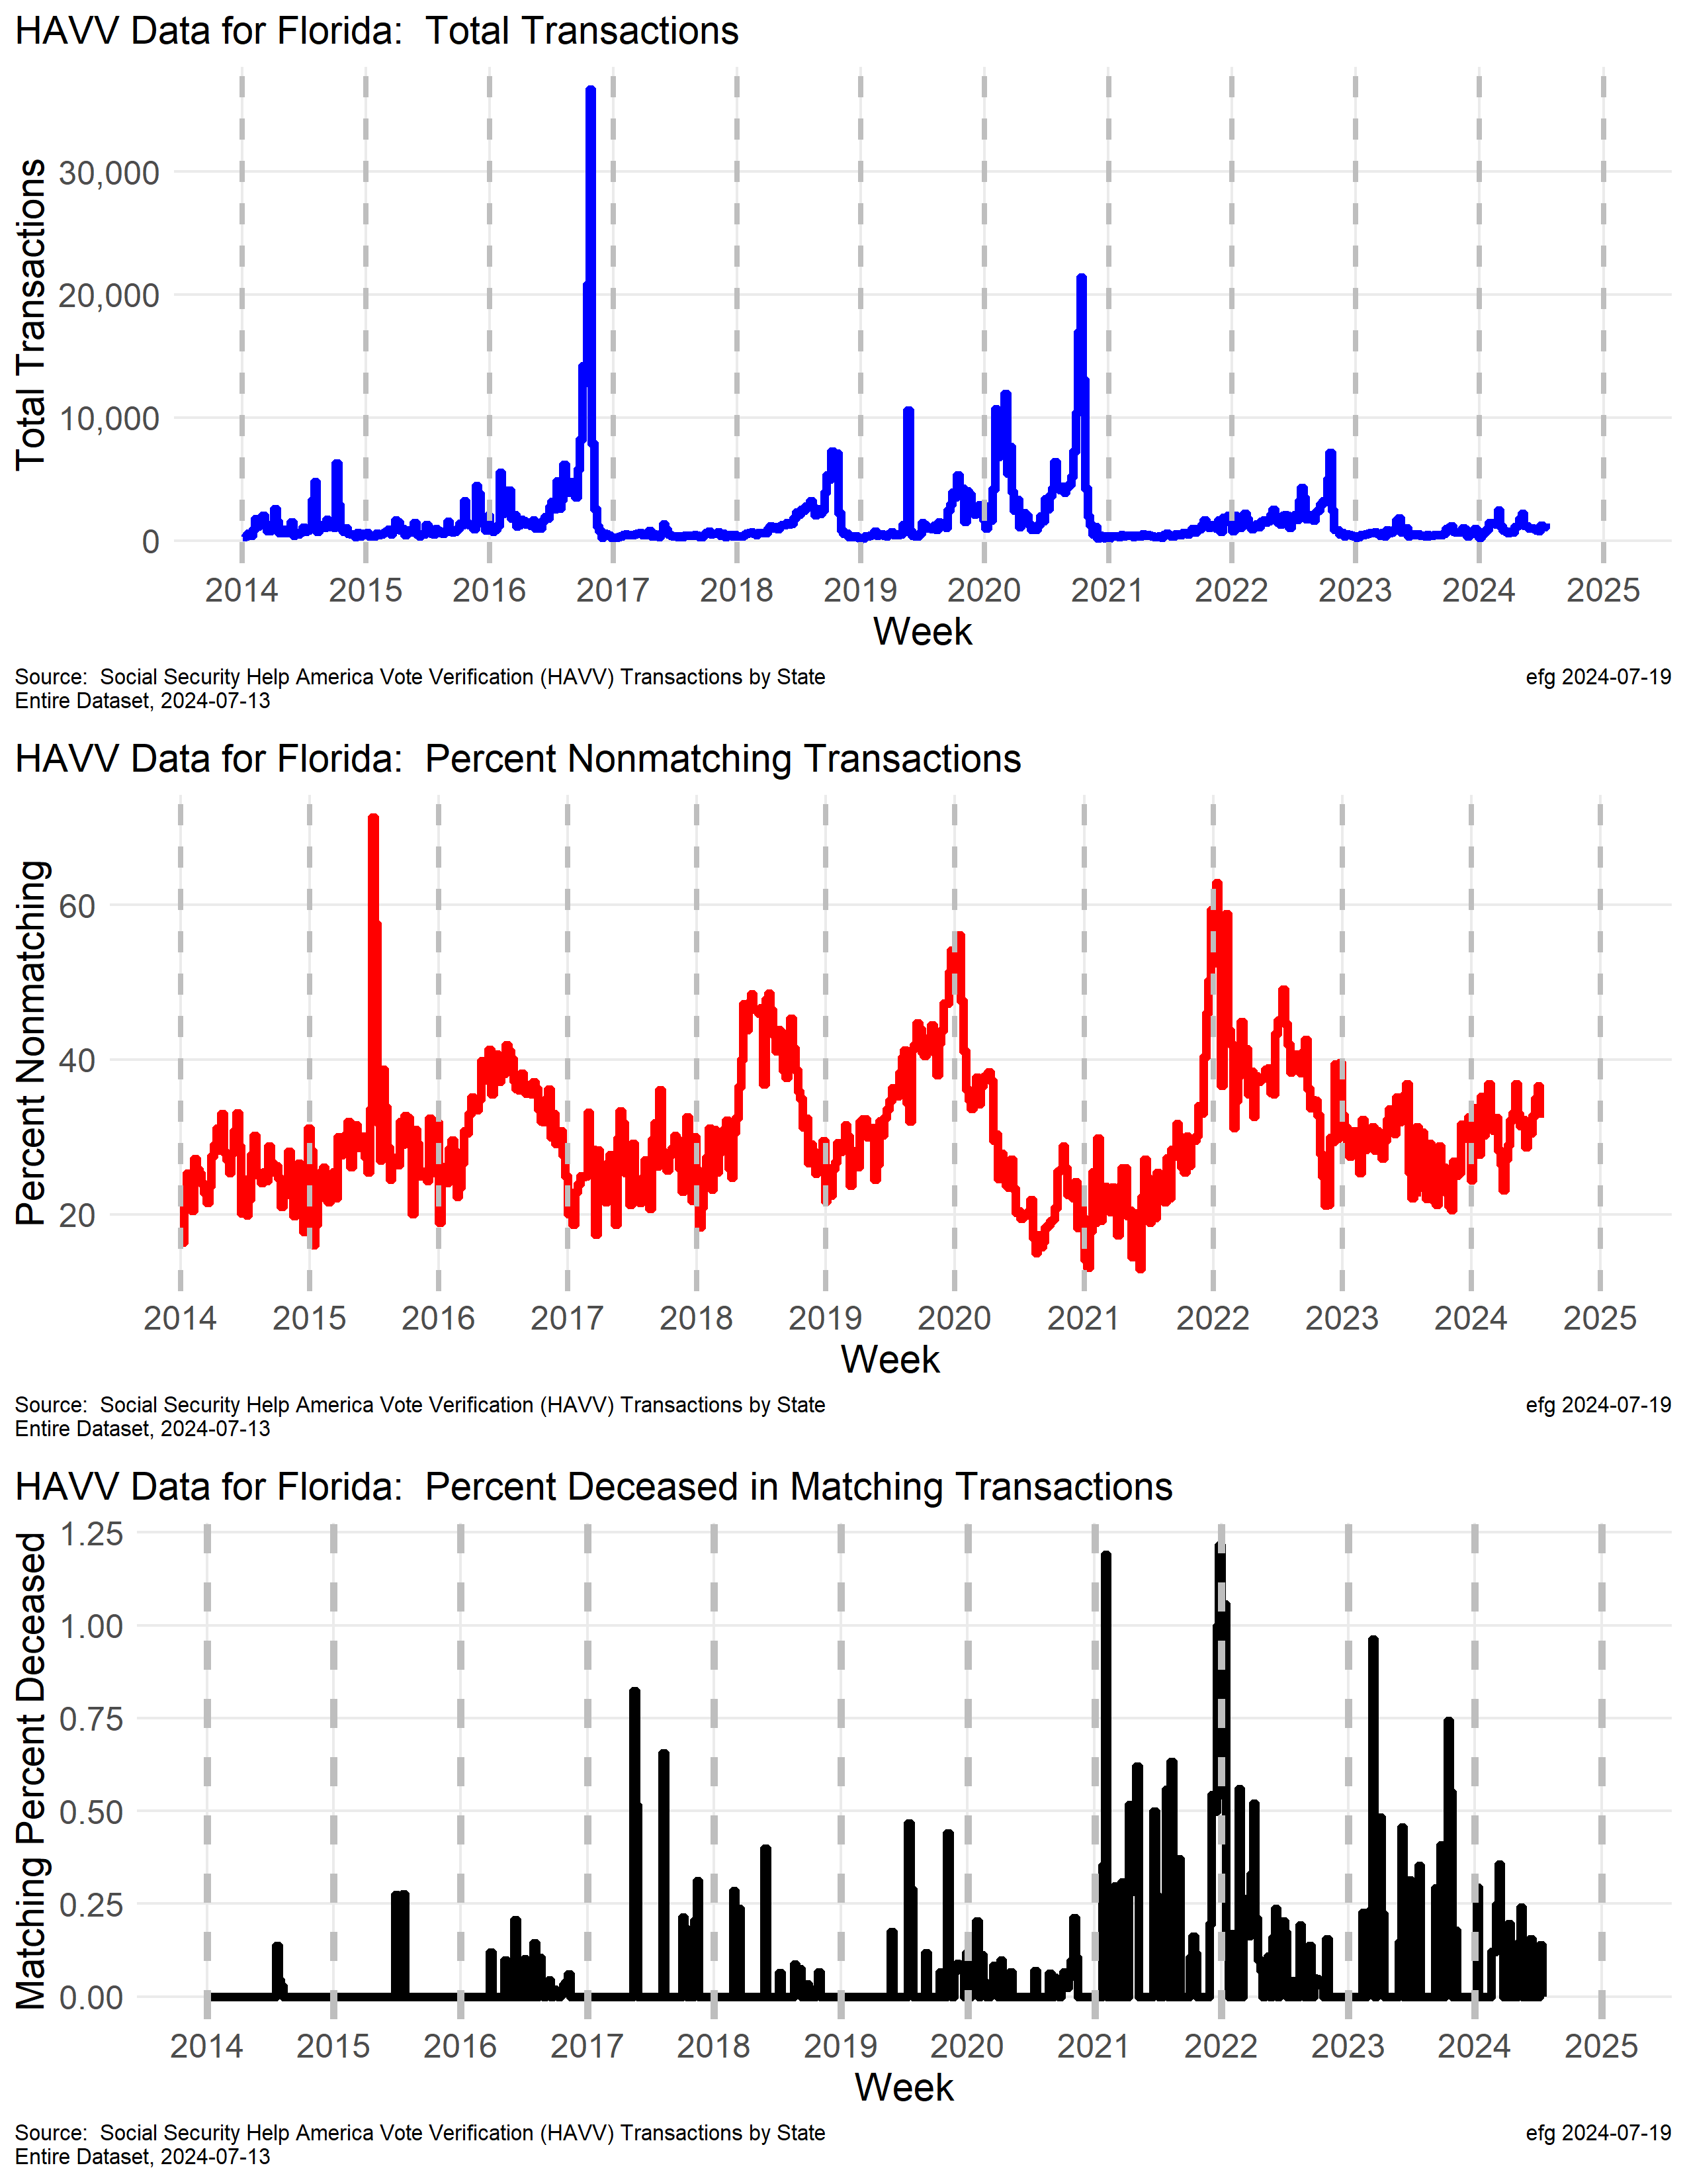
Florida

Slide 21
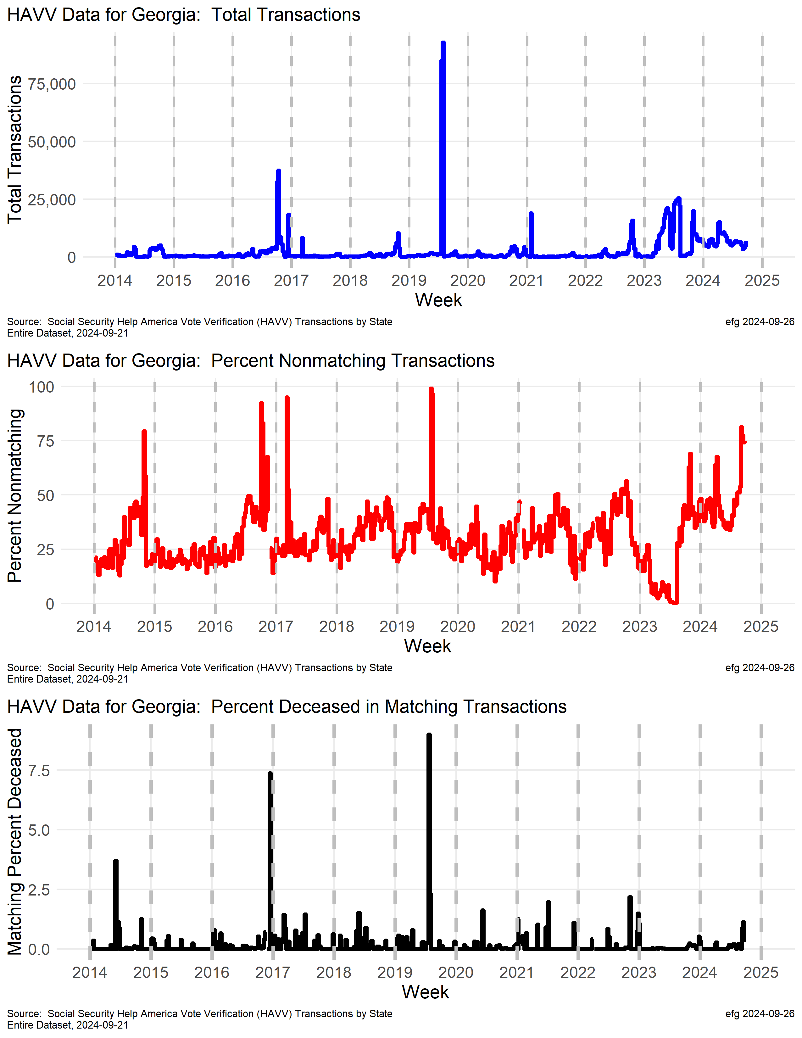
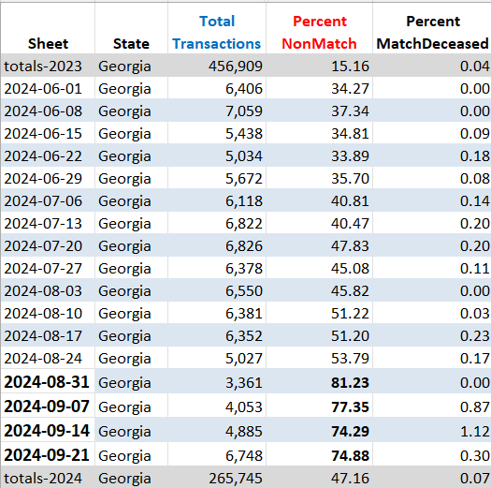
Georgia
watchdoglab.substack.com/p/ questions-about-help-america-vote
In Georgia for fourth consecutive week the HAVV transaction mismatch with Social Security records has been 70% or higher.
For all of 2024 nearly half of transactions have not matched.
Notes:
Georgia is a member of ERIC: https://ericstates.org/about/
2024-09-26
https://x.com/EarlGlynn/status/1839427225356992619
New Help America Voter Verification (#HAVV) data released by Social Security Administration for week ending Sept. 21.
In Georgia for fourth consecutive week the HAVV transaction mismatch with Social Security records has been 70% or higher. For all of 2024 nearly half of transactions have not matched. @RealAmVoice @EIWatchdogs @VoterGA @GAballots
Georgia is a member of ERIC: https://ericstates.org/about/
2024-09-11
https://x.com/EarlGlynn/status/1833912114324631606
Social Security just dropped the latest Help America Vote Verification (#HAVV) Data for week ending Sept. 7. @GaSecofState
@Eiwatchdogs @HonestElections #gapol @VoterGa
Why is the nonmatch rate in Georgia hovering around 80% the last two weeks, and is about 46% for all of 2024?
2024-09-05 https://x.com/EarlGlynn/status/1820559366476755144
Does anyone in Georgia understand Help America Vote Verification (HAVV) data? @EINwatchdogs @HonestElections
#gapol @VoterGa @RepMTG #HAVV
What happened in July 2019 in Georgia? The HAVV transaction rate spiked at 85,000 and 93,000 for two weeks. In the first of those weeks there was a 99% nonmatch rate and a 9% match with deceased rate. How can there be a 99% nonmatch on so many HAVV transactions? Why is the nonmatch rate starting in late 2023 much higher than early 2023? What changed?
Questions about Help America Vote Verification data in many states. Why does the Social Security Administration often have difficulties verifying new voter registration applicants? Why do so many matches for new applications show deceased https://watchdoglab.substack.com/p/questions-about-help-america-vote
2024-09-08 https://x.com/EarlGlynn/status/1832855998354084293
In the week ending Aug 31, Georgia's Help America Voter Verification (HAVV) nonmatch rate was 81.2% through DMV voter registrations. This was the 7th week in 2024 with over 50% nonmatches. @Eiwatchdogs @VoteGA
Why is the HAVV system designed so that it's not possible to see where the nonmatches are occurring?
2024-09-05 https://x.com/EarlGlynn/status/1820559366476755144
Does anyone in Georgia understand Help America Vote Verification (HAVV) data? @EINwatchdogs @HonestElections
#gapol @VoterGa @RepMTG #HAVV
What happened in July 2019 in Georgia? The HAVV transaction rate spiked at 85,000 and 93,000 for two weeks. In the first of those weeks there was a 99% nonmatch rate and a 9% match with deceased rate. How can there be a 99% nonmatch on so many HAVV transactions?
Why is the nonmatch rate starting in late 2023 much higher than early 2023? What changed?
Questions about Help America Vote Verification data in many states. Why does the Social Security Administration often have difficulties verifying new voter registration applicants? Why do so many matches for new applications show deceased https://watchdoglab.substack.com/p/questions-about-help-america-vote
2024-08-18 https://x.com/EarlGlynn/status/1825196908643512792
Or how did 96% of transactions in Georgia non match in July 2019 with 9% matching deceased records?
2024-08-05 https://x.com/EarlGlynn/status/1820559366476755144
Does anyone in Georgia understand Help America Vote Verification (HAVV) data? @EINwatchdogs @HonestElections
#gapol @VoterGa
@RepMTG
#HAVV What happened in July 2019 in Georgia? The HAVV transaction rate spiked at 85,000 and 93,000 for two weeks. In the first of those weeks there was a 99% nonmatch rate and a 9% match with deceased rate. How can there be a 99% nonmatch on so many HAVV transactions? Why is the nonmatch rate starting in late 2023 much higher than early 2023? What changed? Questions about Help America Vote Verification data in many states. Why does the Social Security Administration often have difficulties verifying new voter registration applicants? Why do so many matches for new applications show deceased https://watchdoglab.substack.com/p/questions-about-help-america-vote
C:\efgArchive\2020s\2024\R\HAVV\2024-07-13\States-Data\
Georgia-HAVV-through-2024-07-13.xlsx

Slide 22
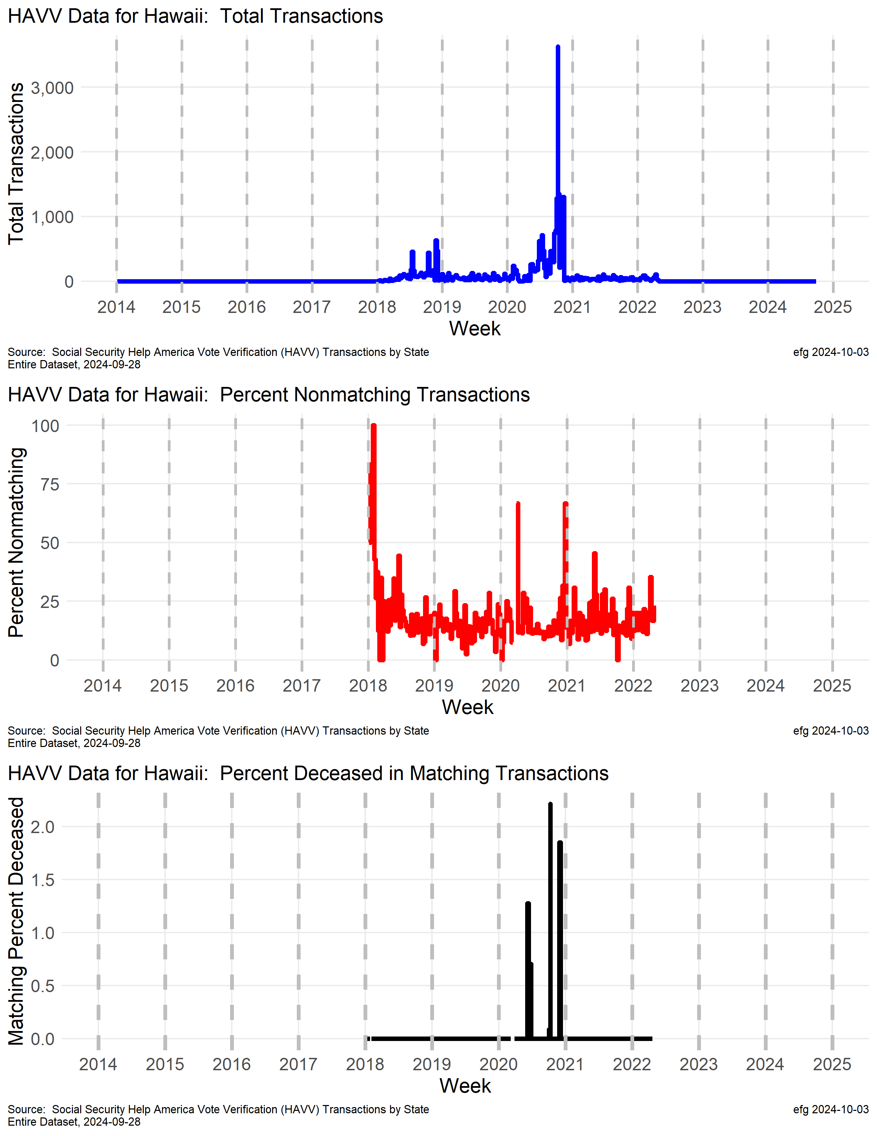
Hawaii

Slide 23
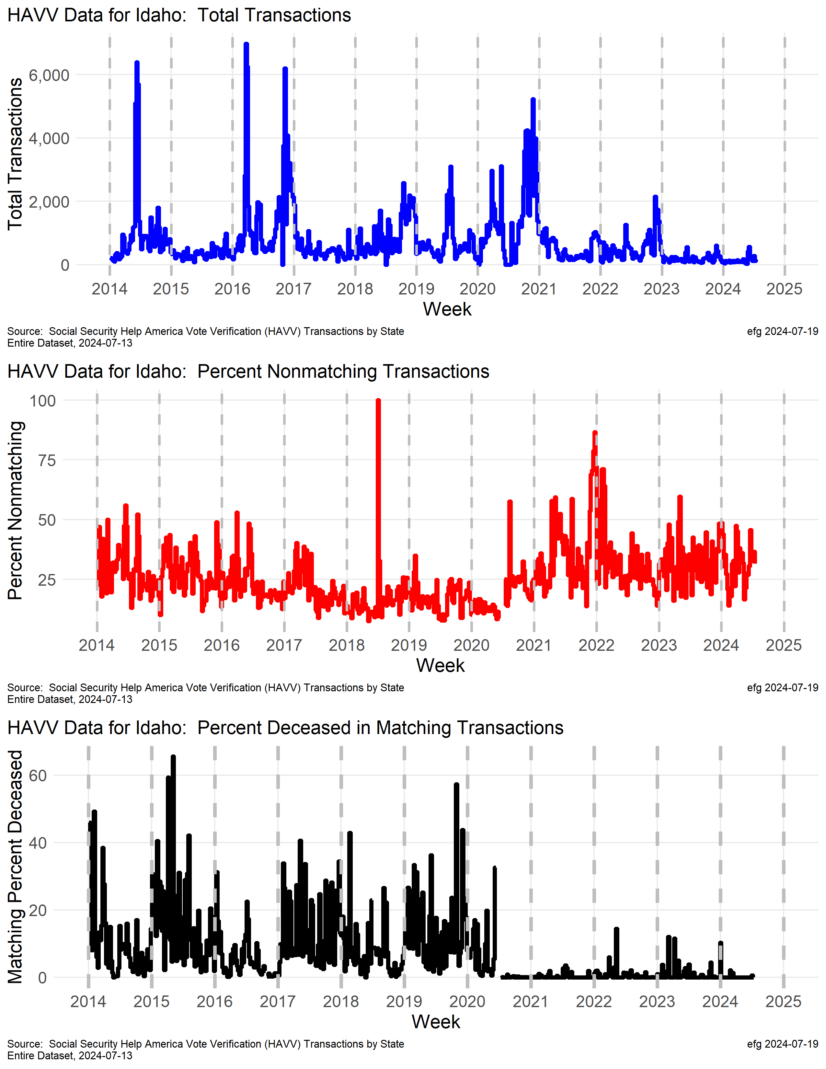
Idaho
Why did the deceased rate decline so much after the 2020 election?

Slide 24
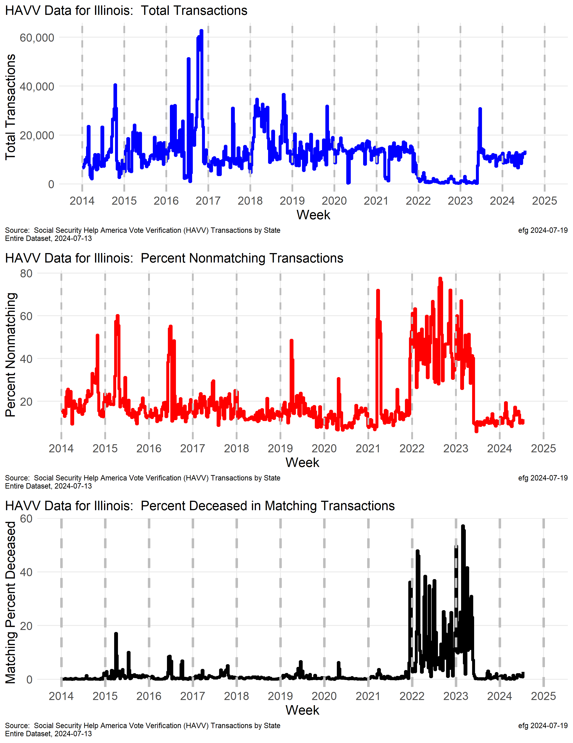
Illinois
For some reason transaction volume in Illinois was down in 2022 and early 2023 to about 1200/week, but nonmatch and match but deceased rates were higher during this same period.
A normal transaction rate was then seen in late 2023 and so far in 2024.
The deceased match rate was quite high in 2022 and early 2023.
watchdoglab.substack.com/p/ questions-about-help-america-vote
Notes:
Member of ERIC: https://ericstates.org/about/

Slide 25
Illinois
For some reason transaction volume in Illinois was down in 2022 and early 2023 to about 1200/week, but nonmatch and match but deceased rates were higher during this same period.
A normal transaction rate was then seen in late 2023 and so far in 2024.
The deceased match rate was quite high in 2022 and early 2023.
watchdoglab.substack.com/p/ questions-about-help-america-vote
Notes:
Member of ERIC: https://ericstates.org/about/

Slide 26
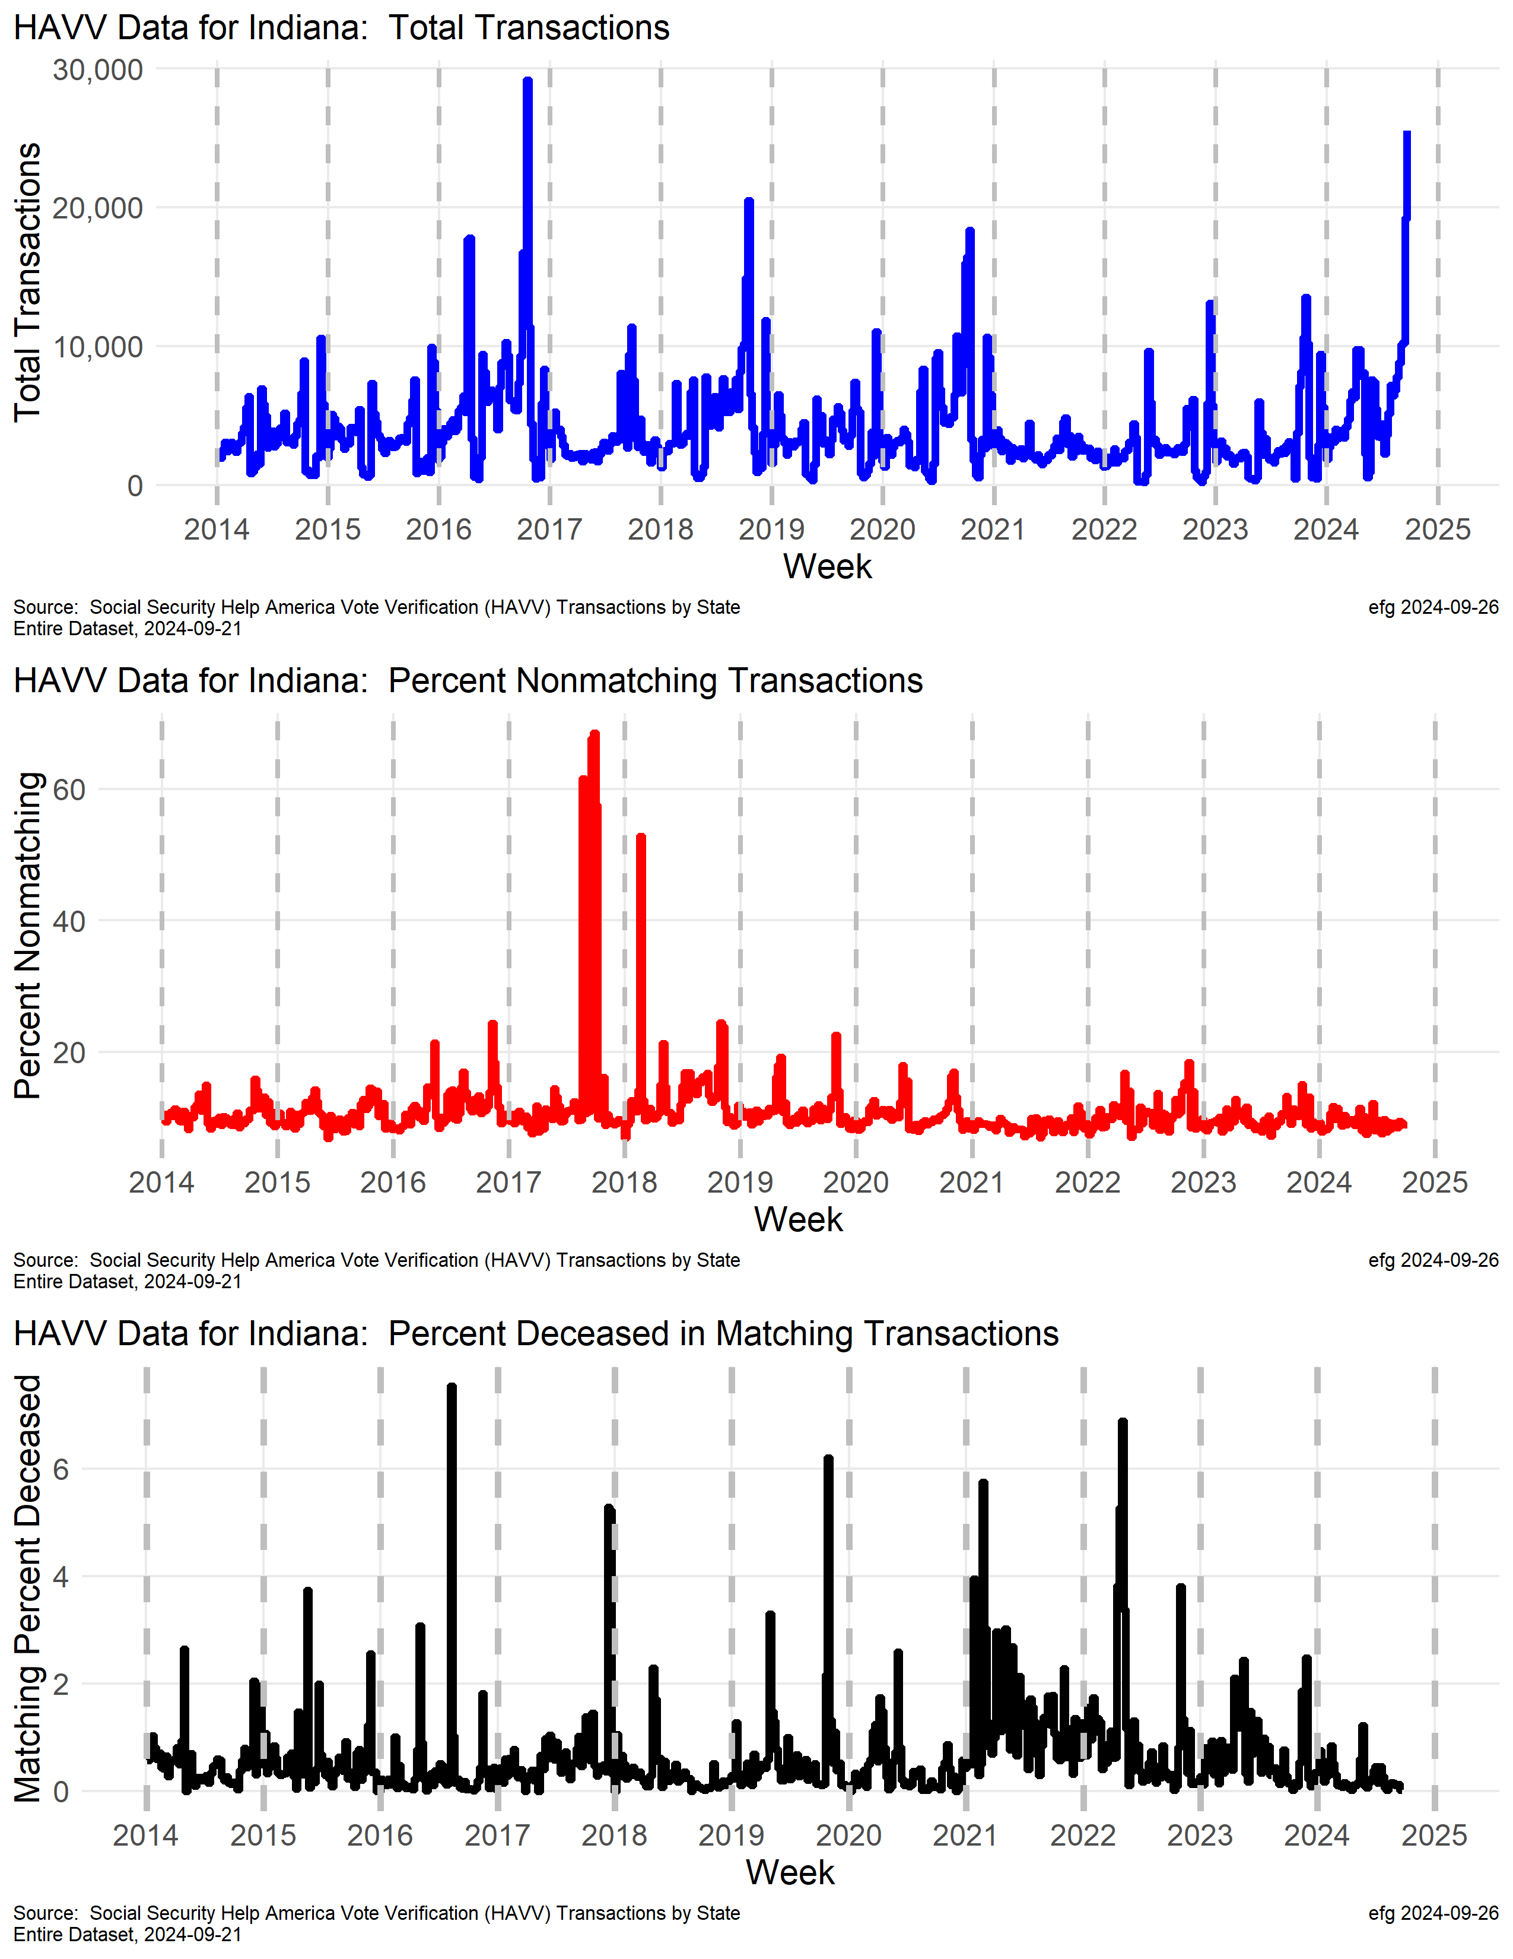
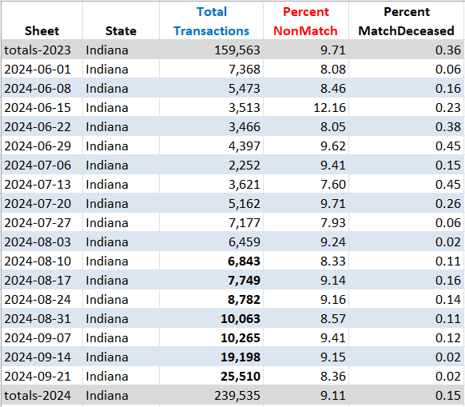
Indiana
watchdoglab.substack.com/p/ questions-about-help-america-vote
In the week ending Sept. 21 HAVV transactions were at the highest level since the 2016 election cycle.
Notes:
2024-09-26
https://x.com/EarlGlynn/status/1839434512331125216
New Help America Voter Verification (#HAVV) data released by Social Security Administration for week ending Sept. 21.
In this most recent week HAVV transactions were at the highest level since the 2016 election cycle.
@RealAmVoice @EIwatchdogs
The weekly transaction counts have been going up for eight straight weeks.

Slide 27
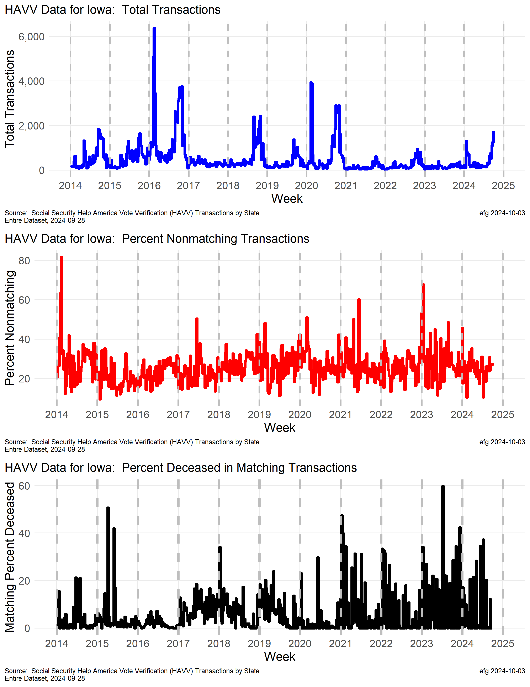
Iowa
Why is the deceased match rate climbing this year? And last year?

Slide 28
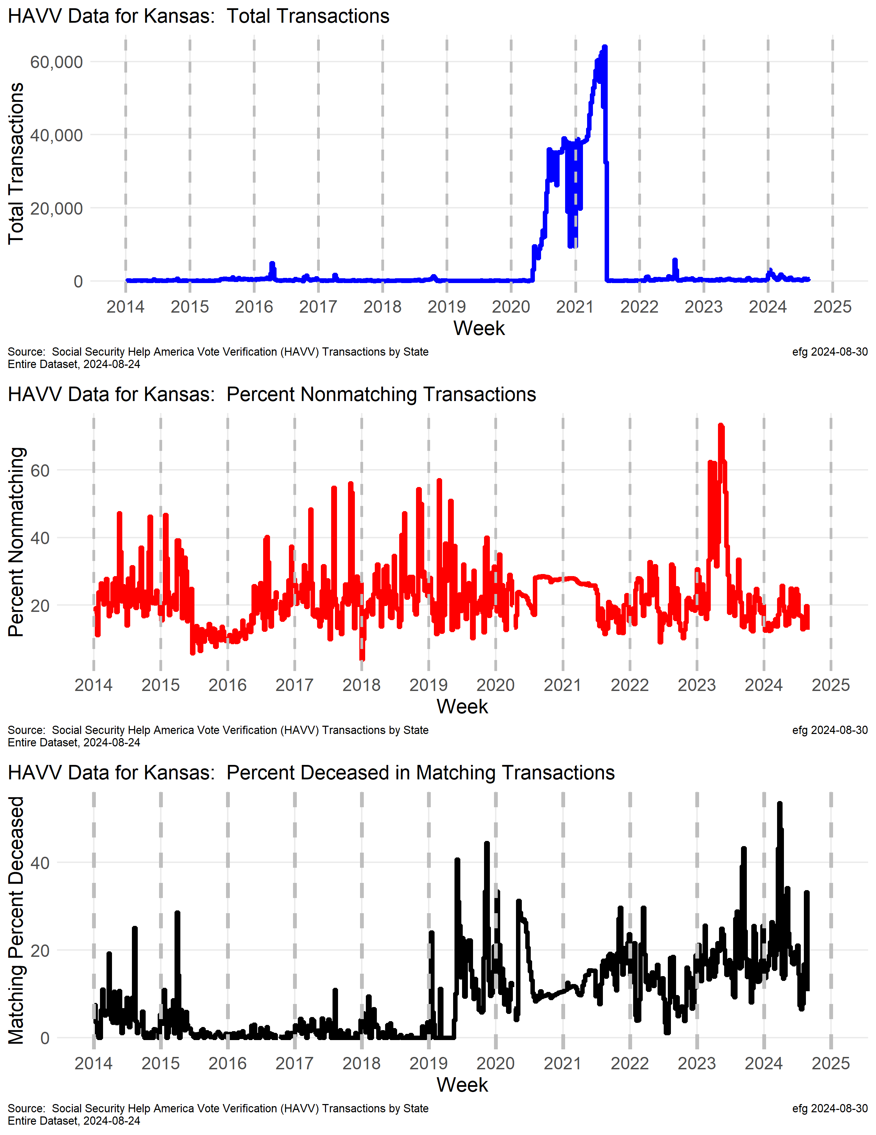
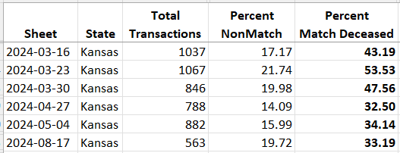
Kansas
Whole State
Processed
Transaction counts suggest whole Kansas voter file processed through HAVV starting in mid-2020? But HAVV supposedly is only for new applications?
Why was nonmatch rate ~30% while processing whole state file?
Increase in death match rate in 2024:
Six weeks show > 30% deceased match rate.
Aug 17 33%
https://watchdoglab.substack.com/p/ understanding-kansas-help-america
Notes:
The blue line shows points for the number of total HAVV transactions for each of the 543 weeks from Jan. 4, 2014 through May 25, 2024.
There are some minor “spikes” in 2016 and 2022, but one large wide spike from mid-2020 through mid-2021 dominates the plot.
A software update might explain this huge number of transactions -- the only two "valleys" in this spike were over Thanksgiving and Christmas weeks.
From mid-2020 through mid-2021 there were over 2 million HAVV transactions. If one subtracts about 20,000 for a “normal” year (like 2014 or 2023), the resulting number is approximately the number Kansans registered at that time.
Was the whole Kansas voter file processed through HAVV starting in mid-2020? But why was that done since HAVV supposedly is only for new applications?
The red line shows the percentage of transactions for each of the 543 weeks that did not match information from Social Security.
This red line shows two curiosities:
While processing the whole Kansas voter file in 2020-2021 new records were set both years: 26.5% of transactions did not match in 2020. 26.7% of transactions did not match in 2021.
What explains the spike in non-matches in 2023 when 30.7% of HAVV transactions matched no Social Security records last year. The weeks of May 6 and May 13, 2023, showed about 73% of transactions did not match. Four other weeks in 2023 had mismatch rates of about 62%.
During the week of March 23, 2024 the HAVV data show Kansas had 1067 total transactions with 835 matches -- so 232 or 21.7% did not match that week (red line in plot above).
But of those 835 matches, the HAVV data show 447 were "Single Match Deceased", which indicates 53.5% of the matches were possibly deceased. Should such a high deceased match percentage trigger some additional investigation?
Curiosities:
Why was the percent deceased in matching records 53.5% during one week March?
Why is this rate for 2024 so far setting a new yearly record of over 23% when the overall rate since 2011 is only 11.5%?
Why has the deceased rate among Social Security matches been trending upward since early 2019?

Slide 29
Kentucky
Not participating in HAVV
Notes:
https://www.ssa.gov/open/havv/
Member of ERIC: https://ericstates.org/about/

Slide 30
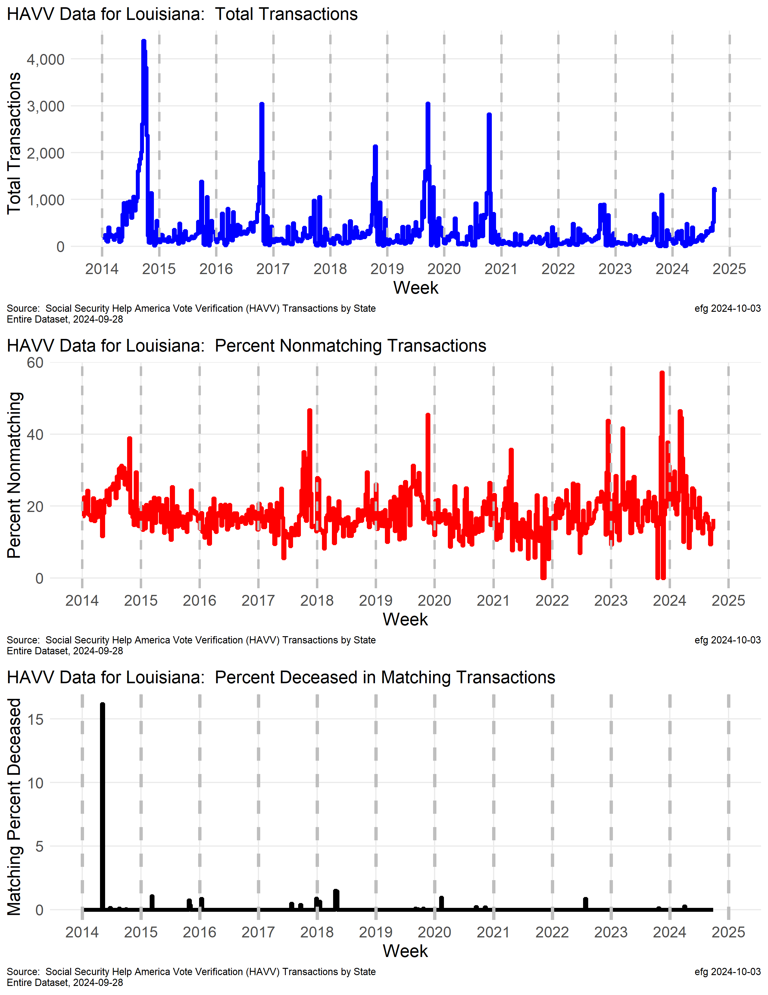
Louisiana

Slide 31
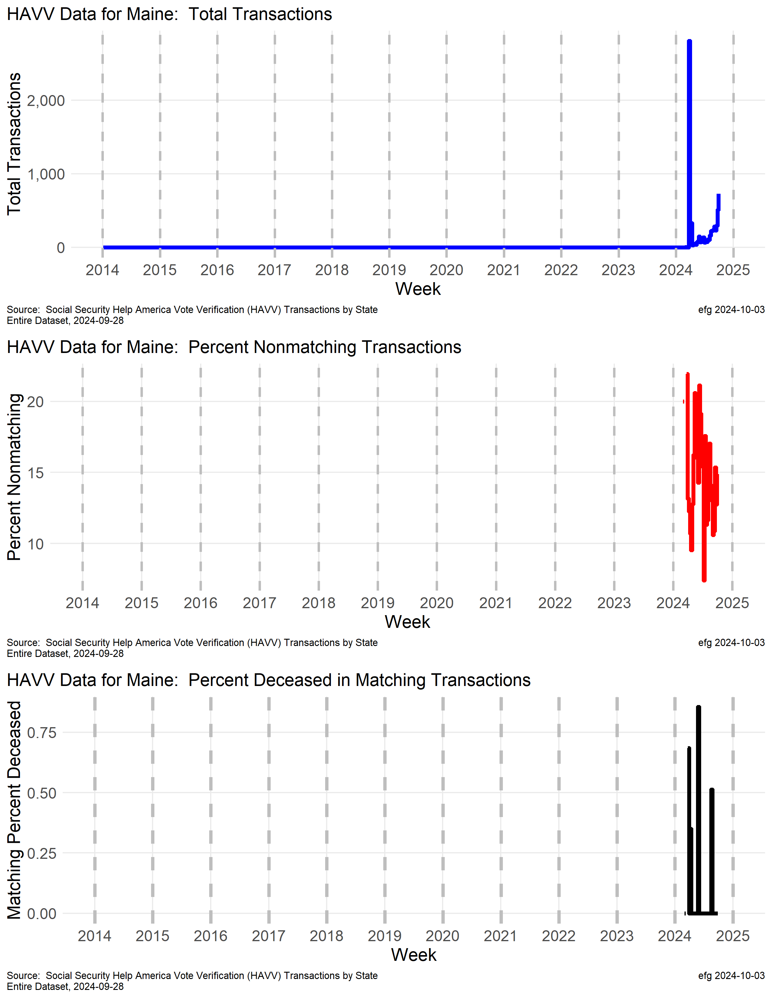
Maine

Slide 32
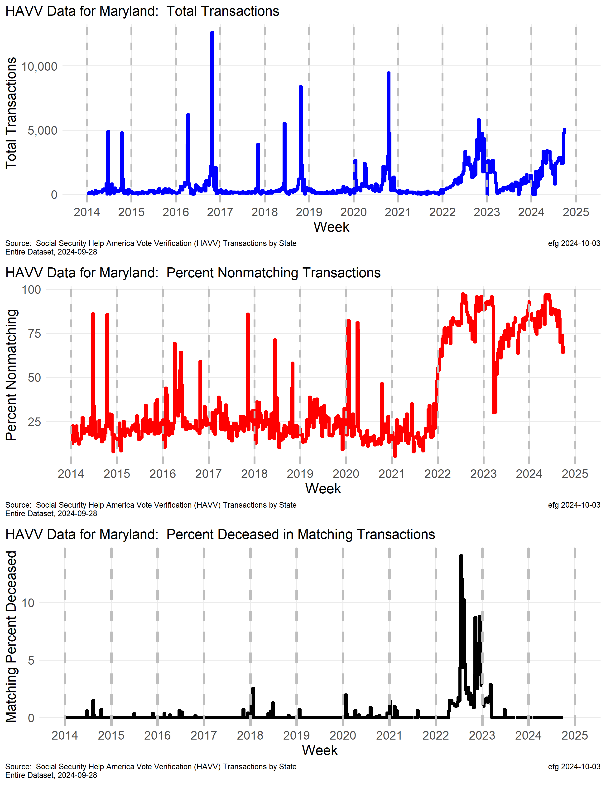
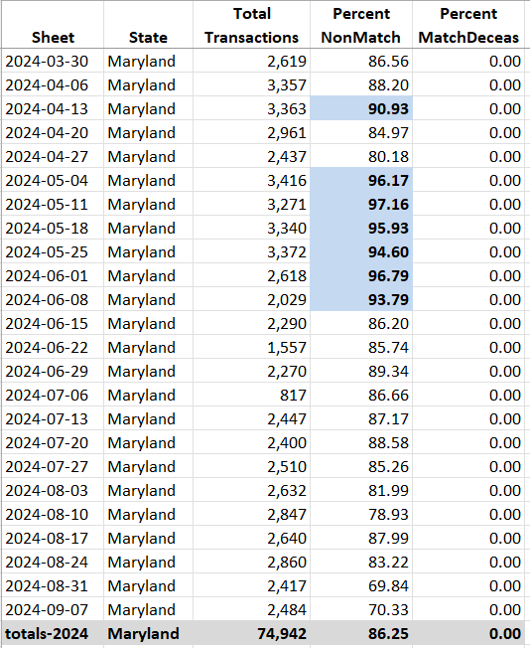
Maryland
watchdoglab.substack.com/p/ questions-about-help-america-vote
What explains the pattern changes in transactions in Maryland starting in early 2022?
Why is the nonmatching rate setting new records in 2022-2024? This rate is often over 75% and sometimes approaches 100%.
Notes:
2024-09-11 https://x.com/EarlGlynn/status/1833917444273865109
Social Security just dropped the latest Help America Vote Verification (#HAVV) Data for week ending Sept. 7. @md_sbe
@Eiwatchdogs @EFFE4USA @WallStreetApes @elonmusk
Why have the Maryland HAVV transactions not matched Social Security data over 86% of the time in 2024? In 2023 83.5% of Maryland's transactions did not match, and in 2022 84.8% did not match. Social Security’s HAVV seems to be designed so problems cannot be traced to their source.
2024-08-18 https://x.com/EarlGlynn/status/1825196738296103375
Voter registrations through the DMV are "checked" via the Help America Voter Verification system. HAVV Stats published by Social Security show problems in many states. The system is designed so problems cannot be traced to their source.
Consider what's going on in Maryland: Many weeks the non-match rate is 75+%. How can that be? Exactly where is that happening? https://watchdoglab.substack.com/p/questions-about-help-america-vote
2024-08-12 https://x.com/EarlGlynn/status/1823022838883778742
HAVV Mystery #2: Who can explain Maryland Help America Vote Verification (HAVV) data? @EIwatchdogs
What explains the pattern changes in transactions in Maryland starting in early 2022?
Why is the nonmatching rate setting new records in 2022-2024?
This rate is often over 75% and sometimes approaches 100%.
Why did the deceased match rate set a new record in mid-2022? https://watchdoglab.substack.com/p/questions-about-help-america-vote… Link to HAVV Mystery #1: https://x.com/EarlGlynn/status/1820559366476755144
Member of ERIC: https://ericstates.org/about/

Slide 33
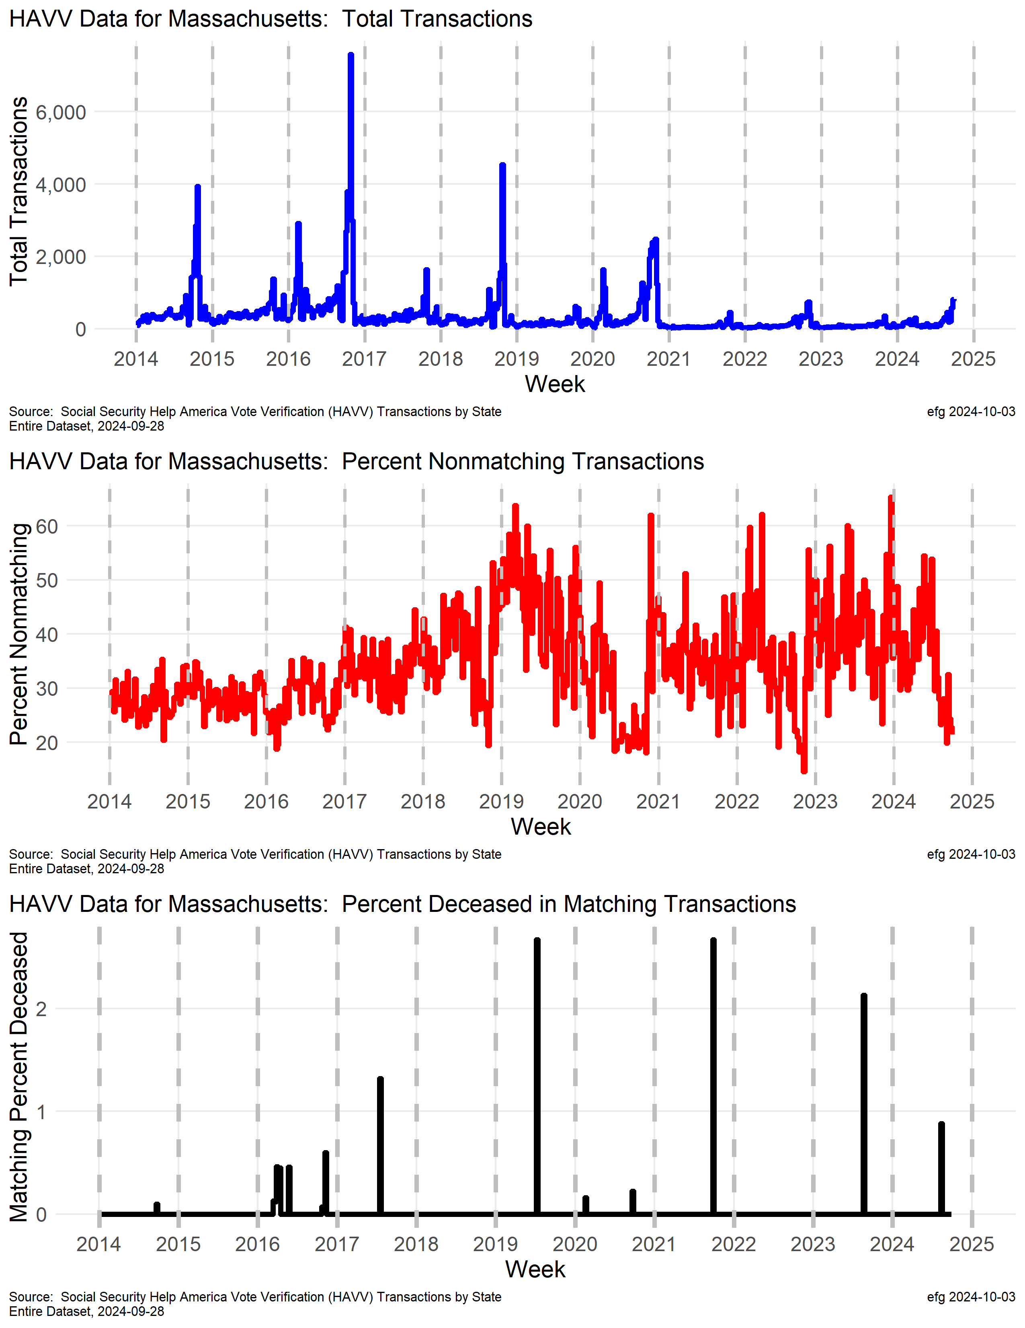
Massachusetts
Weekly transactions in Massachuetts are fairly small.
Massachusetts’ nonmatch rate has been trending upward and is now often over 40%.
Notes:
Member of ERIC: https://ericstates.org/about/

Slide 34
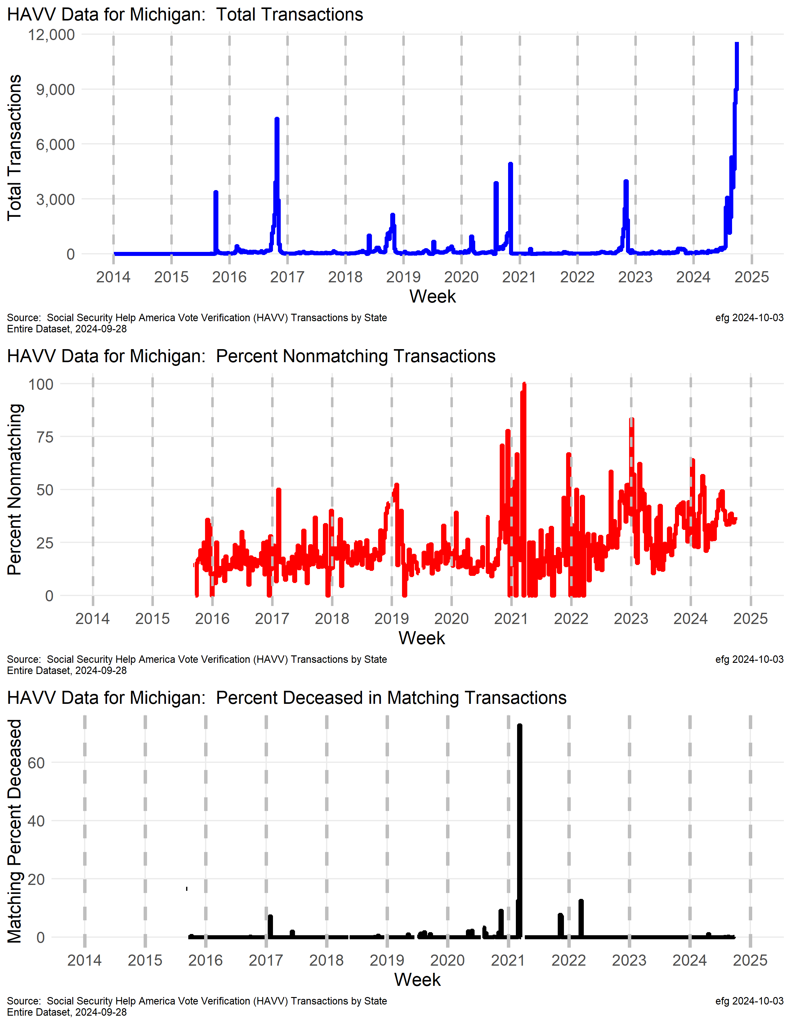
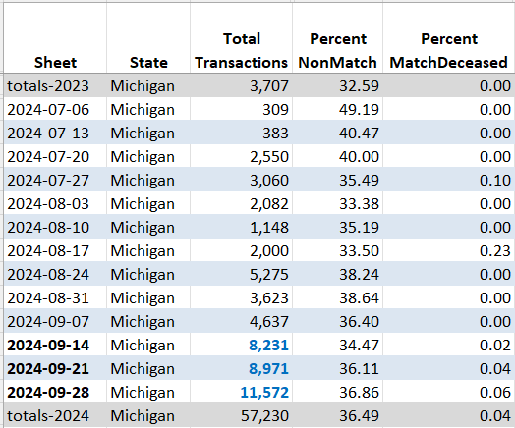
Michigan
watchdoglab.substack.com/p/ questions-about-help-america-vote
All-time record high HAVV transactions occurred weeks ending Sept. 14, 21, 28 eclipsing record from 2016.
Notes:
Michigan is a member of ERIC: https://ericstates.org/about/
2024-10-03 https://x.com/EarlGlynn/status/1841902960760258894
Updated HAVV data for the week ending Sept. 28 shows a new record high weekly transactions in Michigan. @EIWatchdogs
@MIFairElections
https://ssa.gov/open/havv/
2024-09-26
https://x.com/EarlGlynn/status/1839438010376466562
New Help America Voter Verification (#HAVV) data released by Social Security Administration for week ending Sept. 21.
In Michigan for second consecutive week HAVV total transactions set all-time record high. @RealAmVoice @EIWatchdogs @MIFairElections
Michigan is a member of ERIC: https://ericstates.org/about/
2024-09-19
https://x.com/EarlGlynn/status/1836823121938239504
Social Security just dropped the latest Help America Vote Verification (#HAVV) Data for week ending Sept. 14. https://ssa.gov/open/havv/ @Eiwatchdogs @mifairelections
Michigan set all-time record high of weekly HAVV transactions with 8231 breaking record from 2016.
2024-09-11 https://x.com/EarlGlynn/status/1833922781588975862
Social Security just dropped the latest Help America Vote Verification (#HAVV) Data for week ending Sept. 7. https://ssa.gov/open/havv/ @Eiwatchdogs @MIFairElections @PeterBernegger
Why did Michigan’s HAVV transactions start spiking in July 2024?
2024-08-12 https://x.com/EarlGlynn/status/1823022838883778742
HAVV Mystery #2: Who can explain Maryland Help America Vote Verification (HAVV) data? @EIwatchdogs
What explains the pattern changes in transactions in Maryland starting in early 2022?
Why is the nonmatching rate setting new records in 2022-2024? This rate is often over 75% and sometimes approaches 100%.
Why did the deceased match rate set a new record in mid-2022?
https://watchdoglab.substack.com/p/questions-about-help-america-vote…
Link to HAVV Mystery #1: https://x.com/EarlGlynn/status/1820559366476755144
Member of ERIC: https://ericstates.org/about/
C:\efgArchive\2020s\2024\R\HAVV\2024-07-13\States-Data\
Michigan-HAVV-through-2024-07-13.xlsx

Slide 35
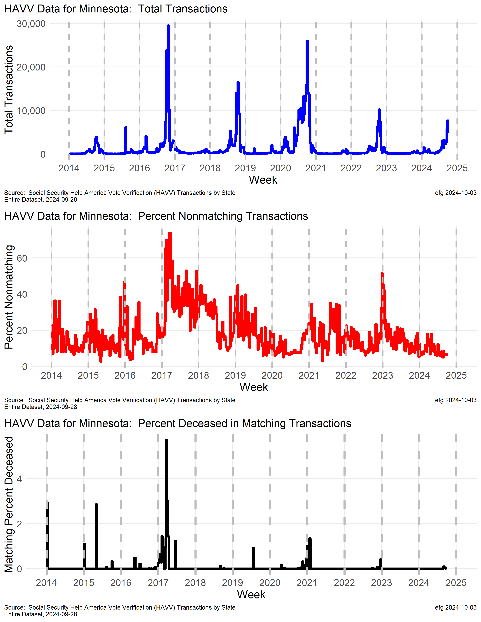
Minnesota
Election year peaks in weekly transaction rates.
Notes:
Member of ERIC: https://ericstates.org/about/

Slide 36
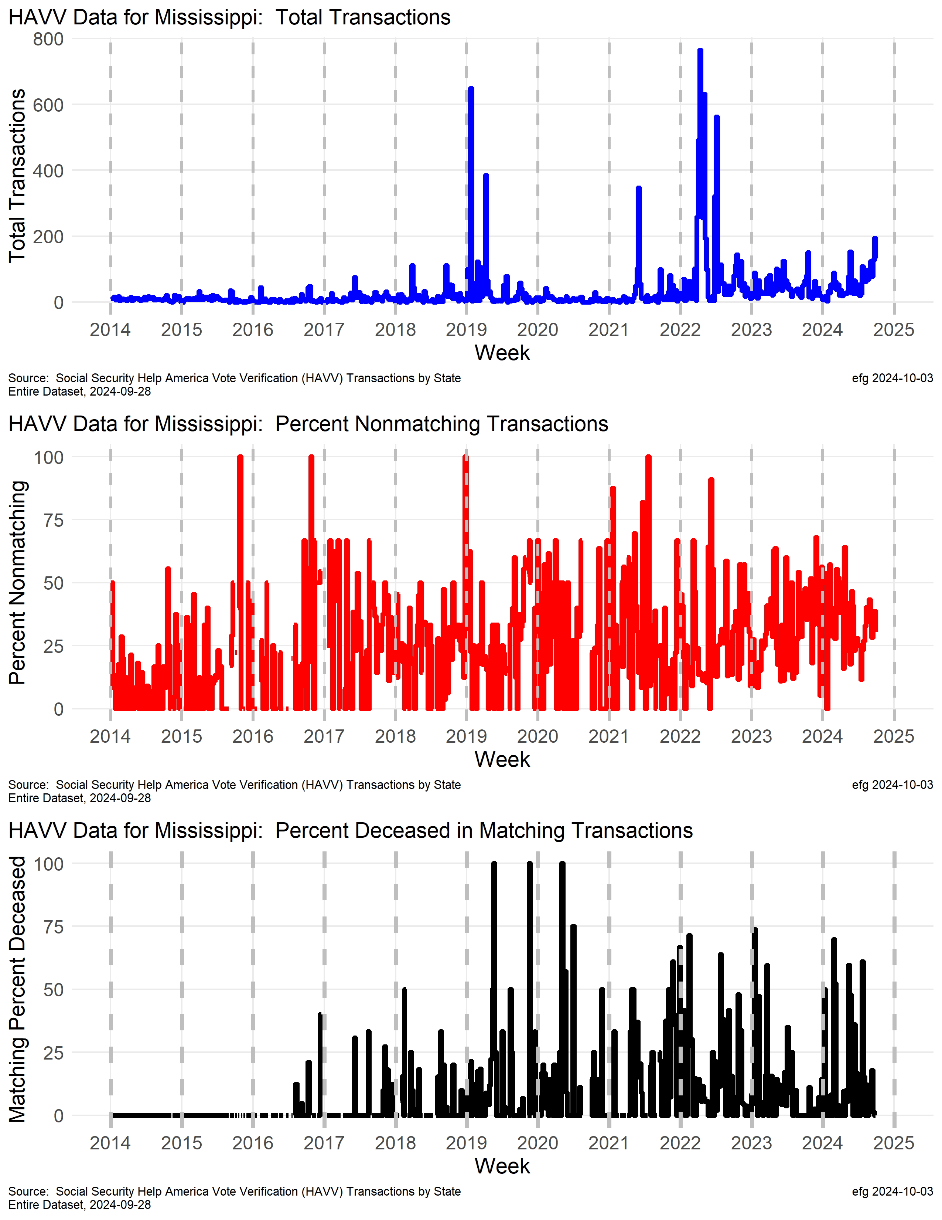
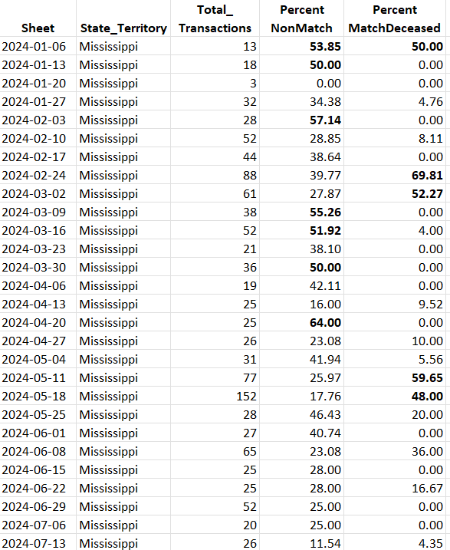
Mississippi
Some weeks in 2024 with 50+% nonmatch rates or 50+% high deceased match rates.

Slide 37
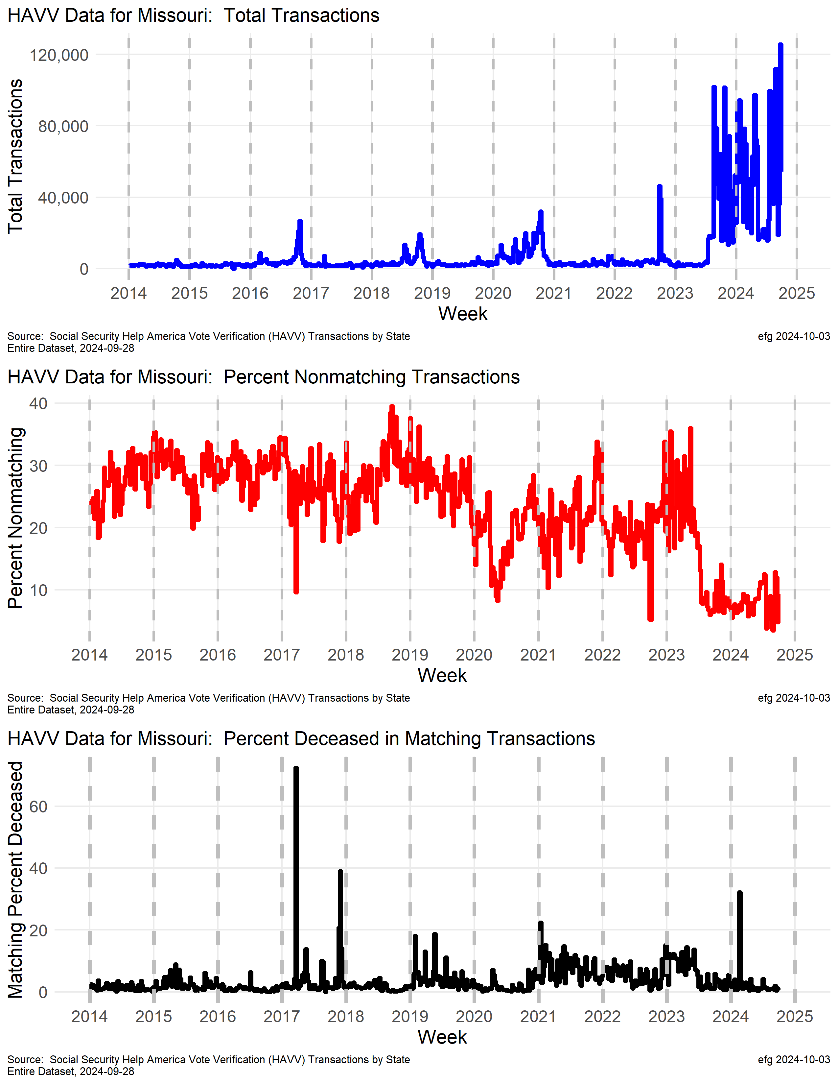
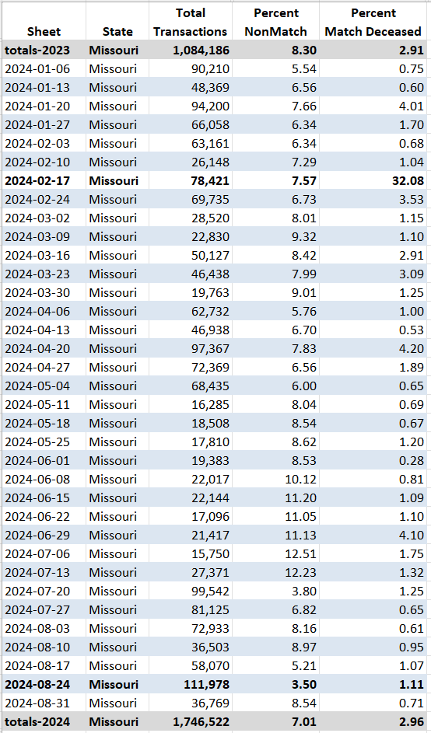
Missouri
watchdoglab.substack.com/p/ questions-about-help-america-vote
Why have HAVV weekly transactions skyrocketed in late 2023 and 2024 with wide week-to-week swings?
Left ERIC Mar. 2023
Notes:
2024-09-21 https://x.com/EarlGlynn/status/1837569055722819826
Left ERIC: https://www.sos.mo.gov/default.aspx?PageId=10296 Electronic Registration Information Center
Help America Vote Verification (HAVV) data from Social Security in the week ending Feb 17, 2024 showed 32% of the matches were to dead people, when the week before was 1% and the week after was 3.5%. Why so high in one specific week?
The non match rates and death match rates look good in Missouri except for that week since Missouri left ERIC (Electronic Registration Information Center) in March 2023, but the number of weekly transactions has been erratic.
HAVV appears to be designed so the locations of problem data cannot be found.
2024-09-10 https://x.com/EarlGlynn/status/1833591140592799755
Missouri's HAVV transactions have been erratic since early 2023. @WallStreetApes @Eiwatchdogs
One possible explanation is the State of Missouri left ERIC roughly in March 2023 according to their SoS press release: https://sos.mo.gov/default.aspx?PageId=10296…
Why was the Missouri HAVV weekly transaction nonmatching rate 20 to 40% under ERIC and has been 10% or less since leaving ERIC?
Why was the Missouri HAVV deceased match rate 32% for the week ending 2024-02-17?
2024-09-07 https://x.com/EarlGlynn/status/1832604590522446183
That was the week ending Feb 17 when those 23,253 matches to deceased amounted to 32.1% of all HAVV matching transactions in Missouri.
That was one huge outlier this year, but the week-to-week Missouri HAVV transactions are quite erratic in 2024, too.
See recent X posting about Help America Vote Verification (HAVV) Mystery #5: Missouri https://x.com/EarlGlynn/status/1829569062575231225
2024-08-30 https://x.com/EarlGlynn/status/1829569062575231225
Help America Vote Verification (HAVV) Mystery #5: Missouri
Why have HAVV weekly transactions in Missouri skyrocketed in late 2023 and 2024 with wide week-to-week swings? @EIWatchdogs
@gatewaypundit
Social Security’s HAVV seems to be designed so problems cannot be traced to their source. https://watchdoglab.substack.com/p/questions-about-help-america-vote…
Link to HAVV Mystery #4: https://x.com/EarlGlynn/status/1826000524719612414
https://publicintegrity.org/politics/elections/who-counts/election-partnership-voters-consequences-eric/
2024-09-18 https://x.com/EarlGlynn/status/1825197344024846437
What explains the HAVV transactions in Missouri this year?

Slide 38
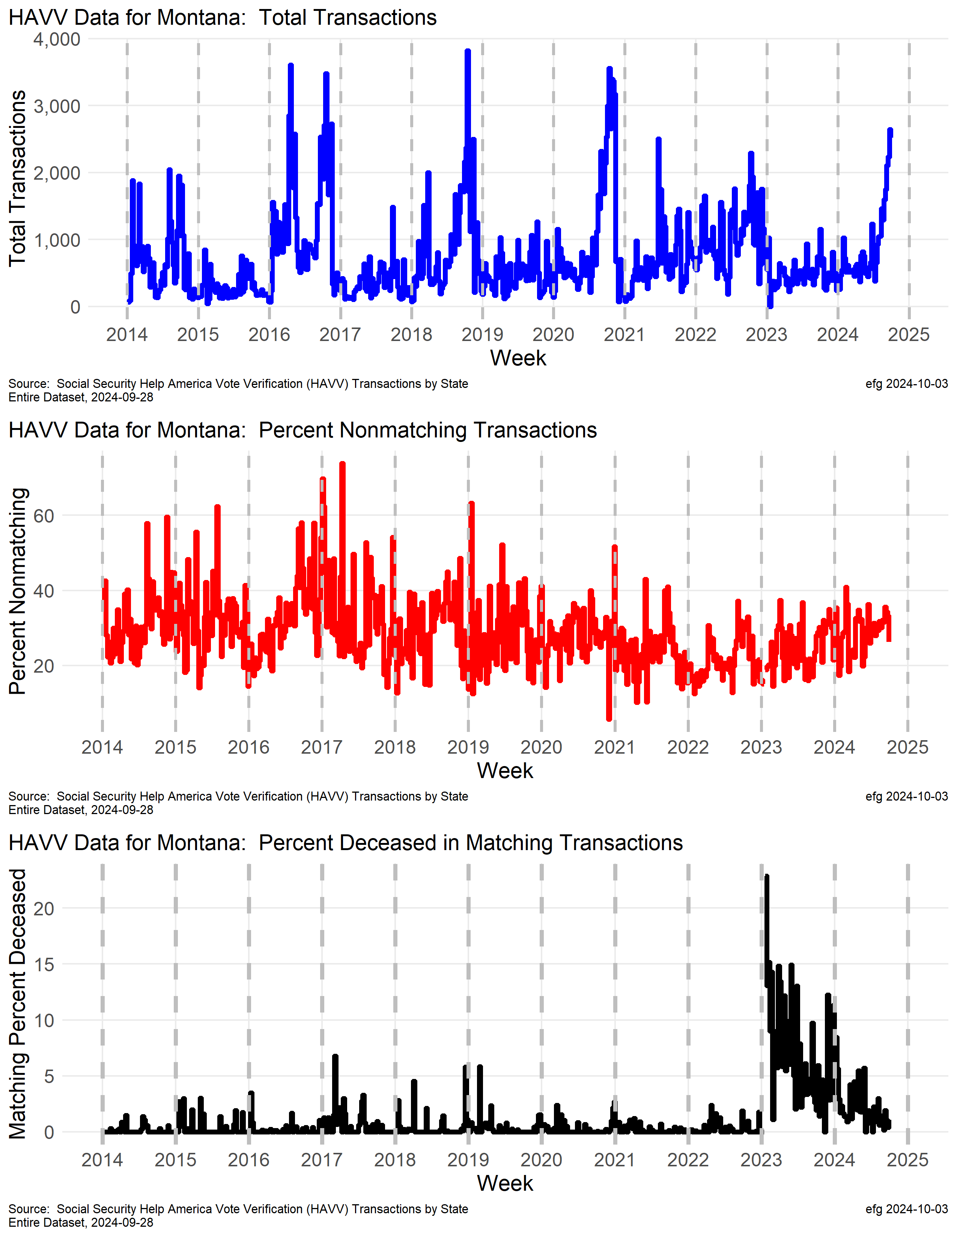
Montana
Why are Montana’s weekly HAVV transactions climbing in 2024?
Why did the deceased match rate greatly increase in early 2023 after being fairly stable from 2014 through 2022? And now is declining?

Slide 39
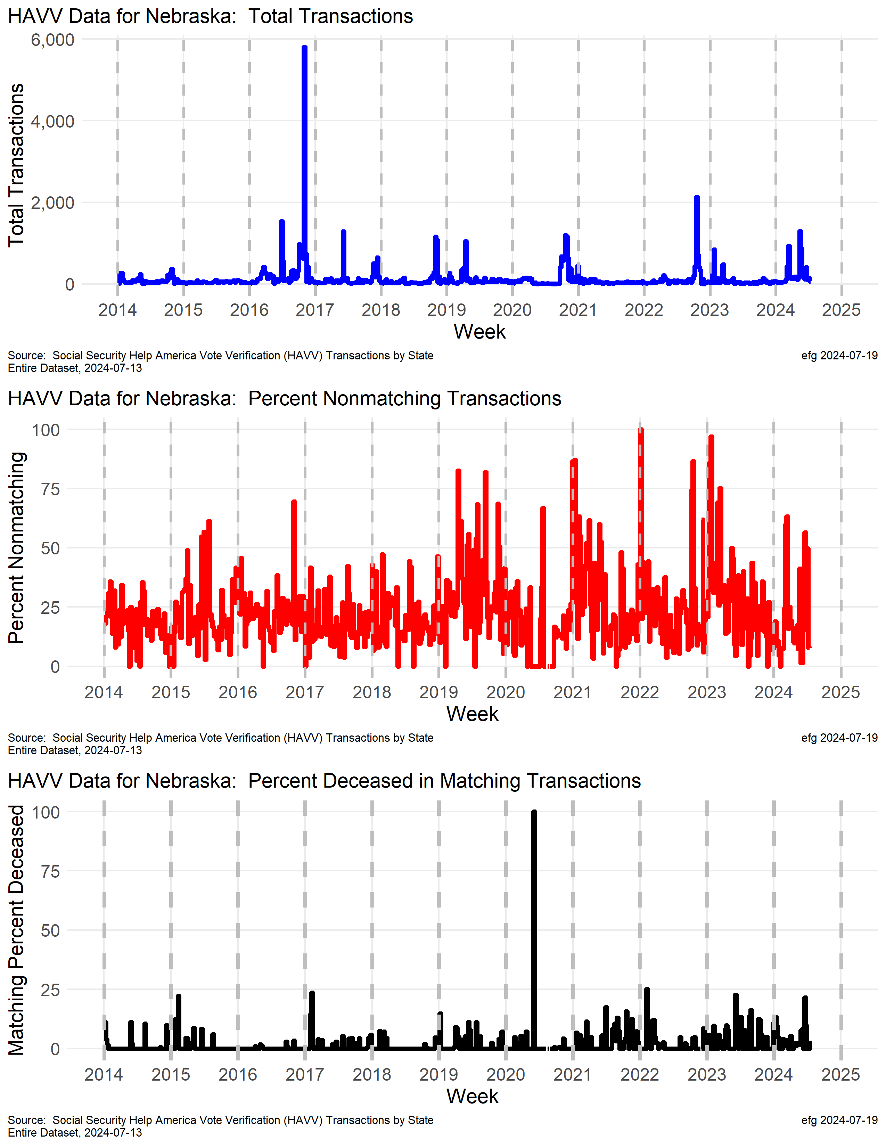
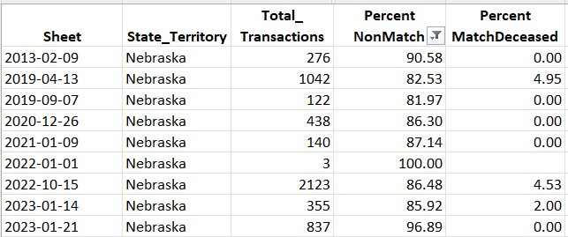
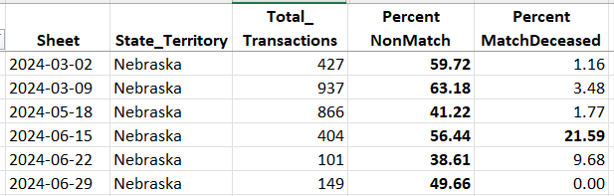
Nebraska
Nonmatching rate has spiked over 50% three times this year.
Percent deceased rate over 21% in week ending June 15, 2024
Small “n” 2 out 2
Notes:
C:\efgArchive\2020s\2024\R\HAVV\2024-07-13\States-Data
weeks in 2024 o nonmatch rats over 40%. Percent deceased match over 21% in week ending 6/15

Slide 40
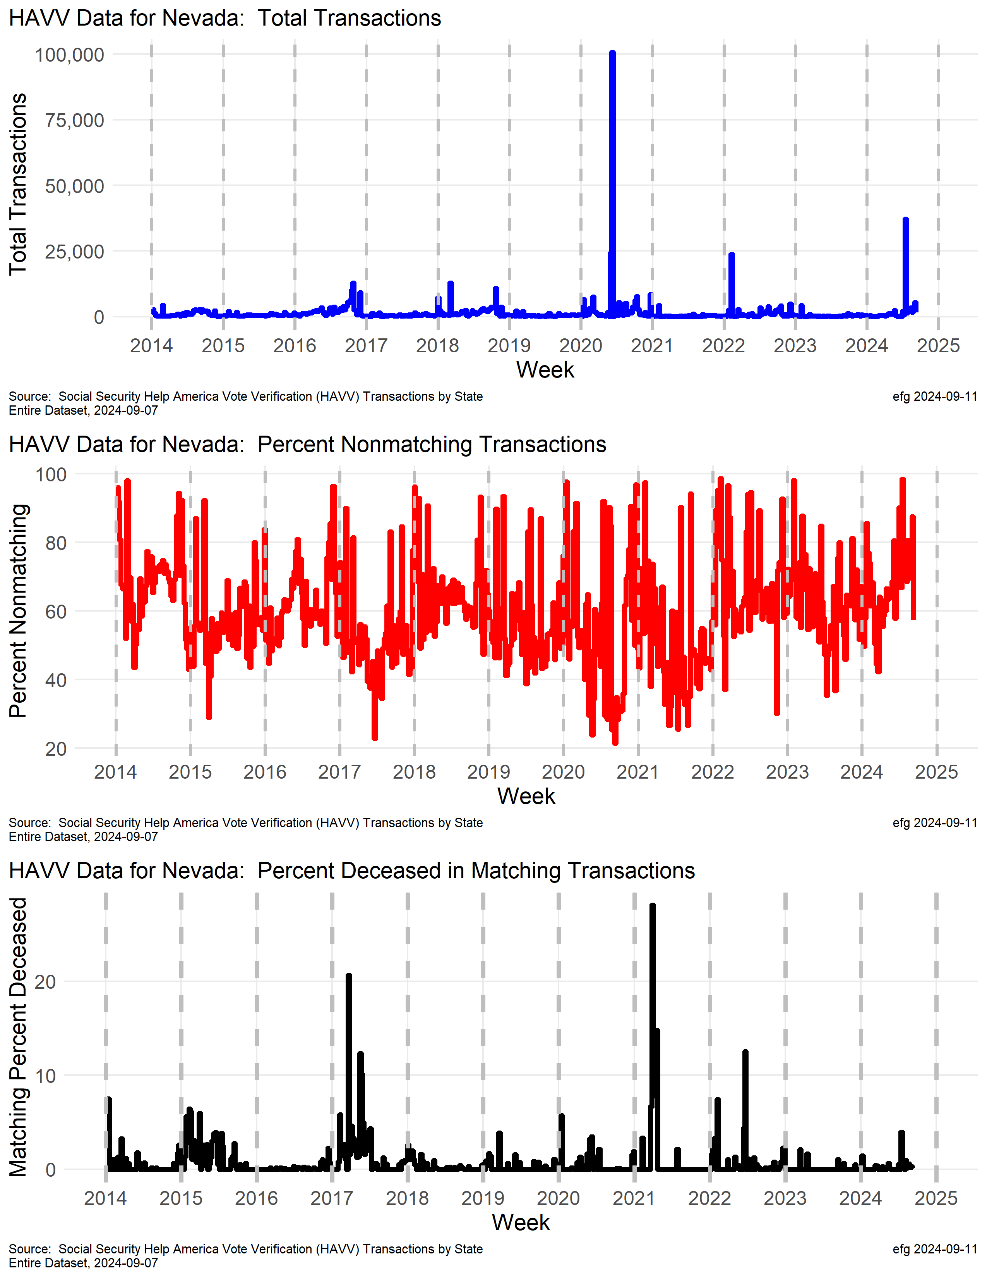

Nevada
watchdoglab.substack.com/p/ questions-about-help-america-vote
The HAVV nonmatching rate has been
consistently above 50% since 2014.
In the week ending July 13, 2024 there were 37,181 transactions, 36,600 nonmatches (98.4%), and 23 of 551 matches were deceased (4%).
Notes:
2024-09-16 https://x.com/EarlGlynn/status/1835878373437960677
Time series for each state reveal more information than the year-to-date totals or a single week of data. Different "stories" for each state appear. @NVSOS @Eiwatchdogs @ChuckMuth @PigpenProject
For example, look at Nevada: Why do more than 50% of the Help America Vote Verification (#HAVV) transactions in Nevada not match any Social Security data for much of the last 10 years?
2024-09-11 https://x.com/EarlGlynn/status/1833929790979452959
Why do more than 50% of the Help America Vote Verification (#HAVV) transactions in Nevada not match any Social Security data? @NVSOS @Eiwatchdogs @ChuckMuth @PigpenProject
Example: In the week ending July 13, 2024 there were 37,181 transactions, 36,600 nonmatches (98.4%), and 23 of 551 matches were deceased (4%).
2024-08-20 https://x.com/EarlGlynn/status/1825960462015738033
Help America Vote Verification (HAVV) Mystery #3: Nevada @EINWatchdogs @PigpenProject @ChuckMuth
In Nevada the HAVV nonmatching rate has been consistently above 50% since 2014.
In the week ending July 13, 2024 NV had 37,181 HAVV transactions, 36,600 nonmatches (98.4%), and 23 of 551 matches were deceased (4%).
Social Security's HAVV seems to be designed so problems cannot be traced to their source.
https://watchdoglab.substack.com/p/questions-about-help-america-vote…
Link to HAVV Mystery #2: https://x.com/EarlGlynn/status/1823022838883778742
Member of ERIC: https://ericstates.org/about/
2024-08-20
Chronic issue of over 50% nonmatch rate

Slide 41

New Hampshire

Slide 42

New Jersey
Election year peak in 2020 election.
Notes:
Member of ERIC: https://ericstates.org/about/
Chronic issue of over 50% nonmatch rate

Slide 43
New Mexico
Not participating in HAVV
Notes:
https://www.ssa.gov/open/havv/
Member of ERIC: https://ericstates.org/about/

Slide 44
Kentucky
Not participating in HAVV
Notes:
https://www.ssa.gov/open/havv/
Members of ERIC: https://ericstates.org/about/
KY, NM, SC

Slide 45

New York
Why does New York's nonmatch rate spike periodically over 90% and is still 40+% most of the time?
New York's match death rate is much lower than many other states.
watchdoglab.substack.com/p/ questions-about-help-america-vote

Slide 46


North Carolina
What caused the transaction spike in April – after the presidential primary? Why is the nonmatch rate trending higher since 2021?
Notes:
2024-07-07 https://x.com/EarlGlynn/status/1810054324443099519
Something very curious in the DMV Help America Vote Verification data from North Carolina is showing up in 2024: A spike in the weekly transactions and an increasing trend in percent nonmatching transactions. @Eiwatchdogs #OnlyCitizensVote @TrueTheVote

Slide 47


Ohio
watchdoglab.substack.com/p/ questions-about-help-america-vote
Why were weekly transaction rates so variable from 2014 to 2017?
Since April 20 Ohio shows ~75% nonmatch rate in HAVV transactions
Notes:
Ohio not in ERIC

Slide 48

Oklahoma

Slide 49

Oregon
Oregon has a periodic spike in transactions before Nov. general elections. Why was the spike in 2022 so small compared to other years?
It's curious that Oregon's nonmatch rate has been trending downward since about 2019, but the match deceased rate has been trending upward during this same period, and sometimes is over 40%.!!
watchdoglab.substack.com/p/ questions-about-help-america-vote
Notes:
Member of ERIC: https://ericstates.org/about/

Slide 50




Pennsylvania
watchdoglab.substack.com/p/ questions-about-help-america-vote
While the nonmatch rate has been trending lower since 2017, and the death match rate is very low, what causes the swings in HAVV transactions starting in late 2021?
Notes:
2024-09-10 https://x.com/EarlGlynn/status/1833594621407924317
The Pennsylvania 2024 HAVV transactions to date (2024-08-31) are 1,632,111, which is already higher than their 2023 total of 1,340,135. @WallStreetApes @Eiwatchdogs
What causes the Pennsylvania HAVV transactions to have such wide swings since late 2021? Pennsylvania is a member of ERIC.
How can one week in 2021 have over 70% nonmatch rate in HAVV transactions?
Member of ERIC: https://ericstates.org/about/

Slide 51


Rhode Island
Problems with small batches should be investigated if we knew “where.”
Small “n”
Notes:
Member of ERIC: https://ericstates.org/about/

Slide 52
South Carolina
Not participating in HAVV
Notes:
https://www.ssa.gov/open/havv/
Member of ERIC: https://ericstates.org/about/

Slide 53


South Dakota
The nonmatching transaction rate hit 67% in the week ending June 1, 2024 when there were only 39 transactions.
Small “n”

Slide 54


Texas
Whole State?
watchdoglab.substack.com/p/ questions-about-help-america-vote
Largest transaction numbers of any state.
What's causing the upward trend in the nonmatch rate since late 2022? [95% and 98% in April 2016 on 60,000+ transactions!]
Why was the deceased match rate so high and erratic in 2023?
Notes:
2024-09-10 https://x.com/EarlGlynn/status/1833584522581205384
The Texas HAVV 2024 transactions to date (2024-08-31) are 3,156,307 but the summary for 2023 was 5,623,371! @WallStreetApes
@Eiwatchdogs
Texas appears to have processed the whole state through HAVV in 2020, and the weekly transaction rates have been trending upward since then.
Why was the Texas HAVV deceased match rate so high in late 2022 and much of 2023?
What explains high nonmatch Texas HAVV weekly rates since late 2022?
Social Security’s HAVV system seems to be designed so problems cannot be traced to their source in the week of reporting!

Slide 55


Utah
2020 Election
Why is Utah’s nonmatching percentage trending upward to sometimes over 50% since after the 2020 election?
Notes:
Member of ERIC: https://ericstates.org/about/
Transaction spike in late 2021, early 2022

Slide 56

Vermont
Notes:
Member of ERIC: https://ericstates.org/about/

Slide 57

Washington
2020 Election year peak in transactions and nonmatch rate.
Notes:
Member of ERIC: https://ericstates.org/about/

Slide 58

Wisconsin
In week ending Jan 13, 2024 there were 53 transactions, 52 matches with 24 matching deceased (46%).
Notes:
Member of ERIC: https://ericstates.org/about/

Slide 59

Wyoming
Curiosity in 2017. Was whole state database processed with a high deceased rate present?

Slide 60










Online GitHub Resources
https://github.com/EarlGlynn/HAVV-analysis
All 50 states + DC; separate Total
Download or View Excel files online
Download or View PNGs/PDFs online
Notes:
More recent updates available. Look for folder with newer date.

